Slide 1

Inducing lexical semantic generalizations
Aaron Steven White
University of Rochester
Mayfest
University of Maryland
17 May 2025

Slide 2
Determiners must be non-relational.
Lexical semantic constraints
Descriptive adequacy
evidence for
Lexical semantic generalizations
All determiners are conservative.
Notes:
To discover lexical semantic constraints, like “determiners must be conservative”, we use lexical semantic generalizations, like “all determiners are conservative”, as evidence, with the ultimate aim of obtaining a descriptively adequate lexical semantic theory: a theory that explains why the lexical semantic generalization–or hopefully some collection of such generalizations–holds.

Slide 3
Lexical semantic constraints
Descriptive adequacy
evidence for
Lexical semantic generalizations
Observational adequacy
Observational adequacy
evidence for
Acceptability, felicity, naturalness, … judgments
Inference judgments
Challenging to achieve when the relevant area of lexicon is large/open
Notes:
To discover lexical semantic generalizations, we need to synthesize evidence from acceptability, felicity, and naturalness judgments on the one hand, and inference judgments on the other, with the aim of obtaining an observationally adequate description of the data. Deriving observationally adequate lexical semantic generalizations turns out to be quite challenging to achieve when we move to larger and larger subsets of the lexicon for a variety of reasons I’ll discuss in a second.

Slide 4
Lexical semantic constraints
Goal 2
evidence for
Lexical semantic generalizations
Goal 1
evidence for
Acceptability, felicity, naturalness, … judgments
Inference judgments
Notes:
My goal in this talk is to meet these challenges by developing a modeling framework that can be used to automatically discover observationally adequate lexical semantic generalizations by synthesizing large acceptability and inference judgment datasets and that is expressive enough to state and quantitatively compare lexical semantic constraints as a means to reaching descriptively adequate theories.

Slide 5
Challenges
The Framework
The challenges of inducing lexical semantic generalizations from large datasets.
A framework for discovering observationally adequate lexical semantic generalizations
Descriptive Adequacy
Some Generalizations
A roadmap for using the framework to compare proposed lexical semantic constraints.
A selection of the generalizations that we discover when applying the framework to the MegaAttitude data.
Notes:
I’ll start with a discussion of the various challenges that arise when trying to induce lexical semantic generalizations from large datasets. I’ll then turn to the framework before discussing a few–to my knowledge novel–generalizations about clause-embedding predicates that we find when using this framework in conjunction with the MegaAttitude datasets, which measure the distributional inferential properties of a wide variety of clause-embedding predicates in English. I’ll finally lay out a roadmap for using this framework to compare proposed lexical semantic constraints.

Slide 6
Challenges

Slide 7
Challenge
The kinds of distributionally and inferentially defined properties we develop generalizations around are not always readily apparent in large-scale datasets.
Example
Tonhauser et al. 2018, Degen & Tonhauser 2022
When attempting to measure veridicality/factivity, we end up with more gradience than we might have expected.

Slide 8
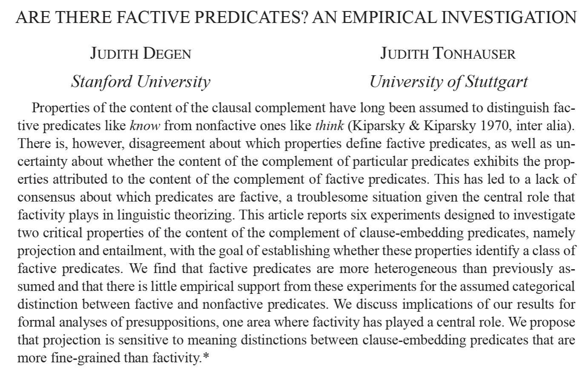

Slide 9
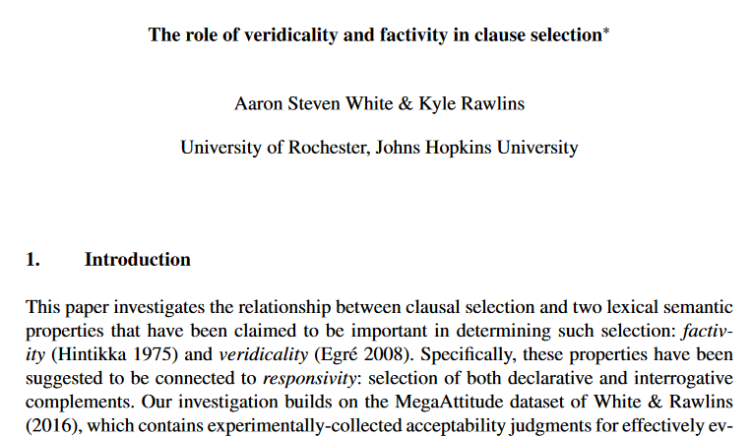
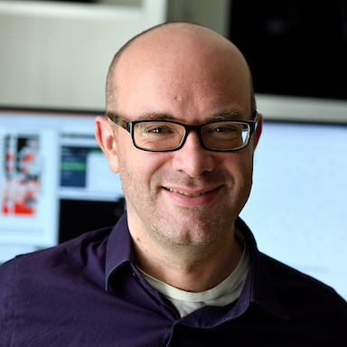
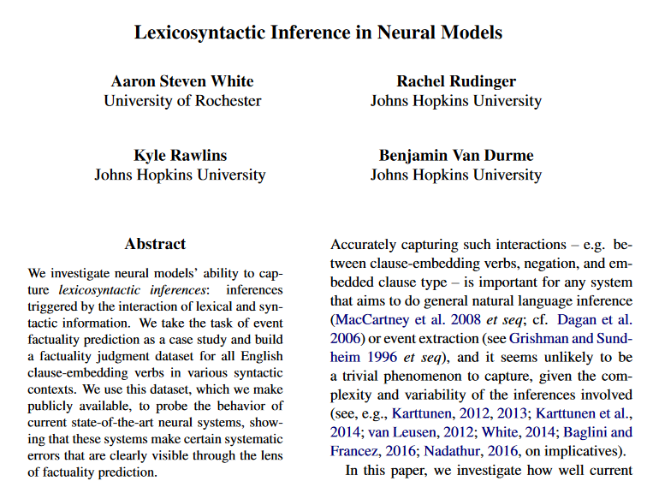
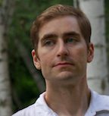
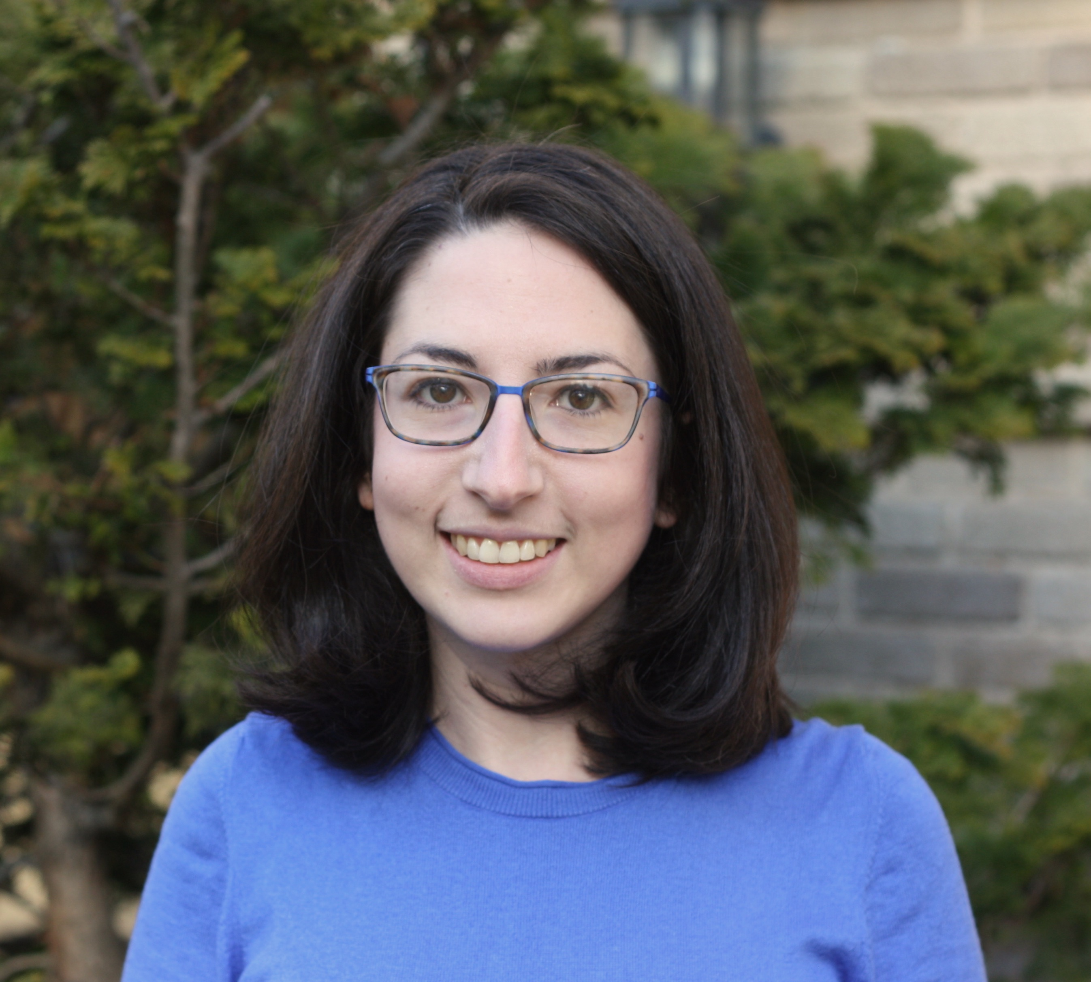
Kyle Rawlins
Johns Hopkins University
Ben Van Durme
Johns Hopkins University
Rachel Rudinger
University of Maryland

Slide 10
yes
Factives
Someone didn’t __ that a particular thing happened?
Did that thing happen?
Antiveridicals
Nonfactives
Veridicals
no
yes
Someone __ed that a particular thing happened?
Did that thing happen?
White & Rawlins 2018

Slide 11
Potential Implication
We cannot reference factivity (at least as a discrete property) in our lexical semantic generalizations.
Possibility
We state our lexical semantic generalizations in terms of continuous measures of our traditional properties.

Slide 12
yes
Someone didn’t __ that a particular thing happened?
Did that thing happen?
no
yes
Factivity = max(0, min( , ))
Someone __ed that a particular thing happened?
Did that thing happen?
White 2021

Slide 13
Example #1
see Fillmore 1963, Bartsch 1973, Horn 1971, 1978, 1989, Gajewski 2007, Romoli 2013
Factives are not neg-raisers.

Slide 14
Neg-raising
X
Neg-raising
Nonfactive
Non-neg-raising
Factive
Non-neg-raising
Factivity

Slide 15
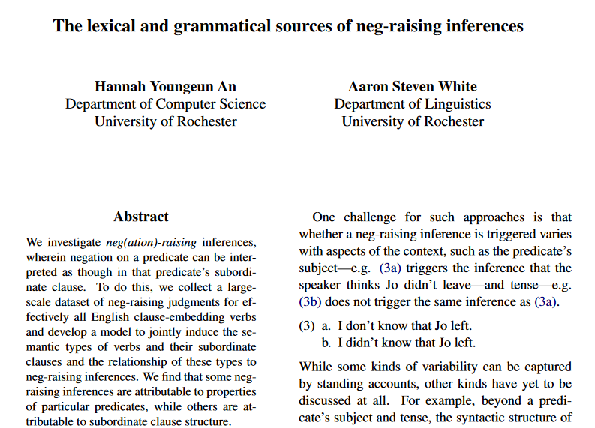
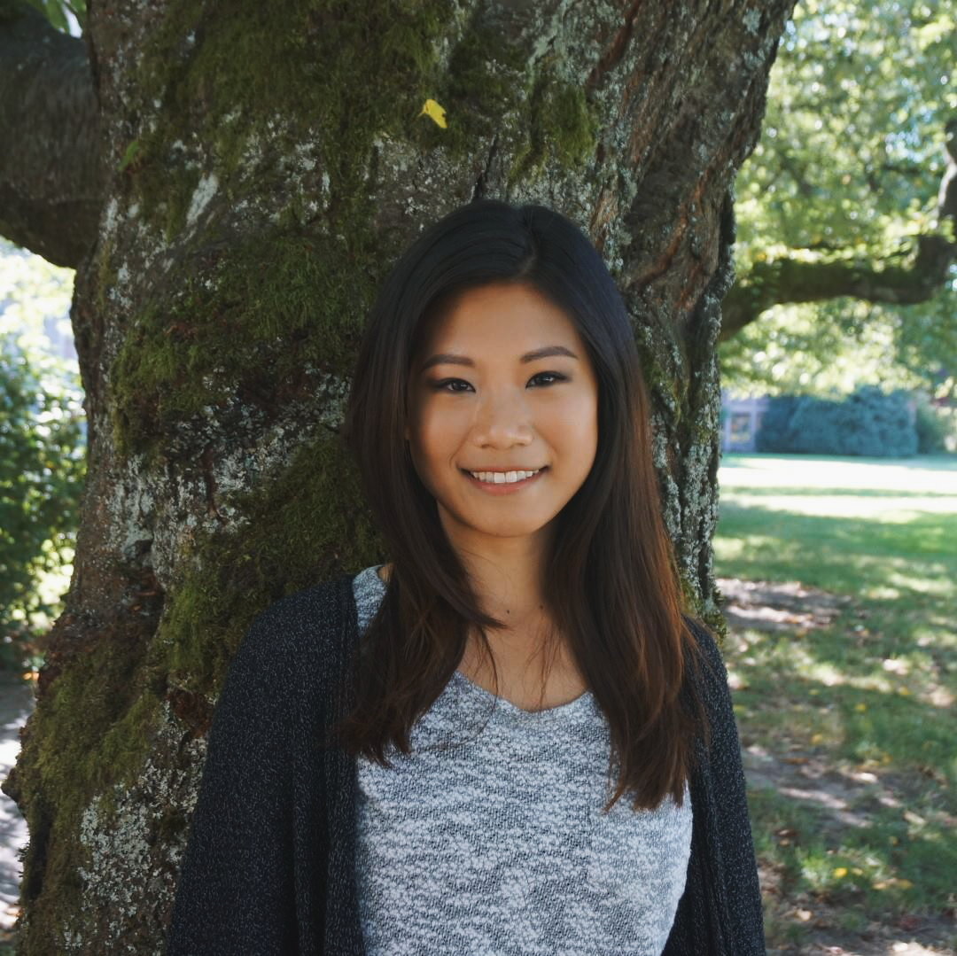
Hannah An
University of Rochester
If I were to say
a particular person {did, does, is, was}n’t __ that a particular thing happened,
how likely is it that I mean
that person __ that that thing didn’t happen?
An & White 2020

Slide 16
Neg-raising
X
Neg-raising
Nonfactive
Non-neg-raising
Factive
Non-neg-raising
Factivity

Slide 17
Challenge
How do we know what the relationship between measures should look like in any particular case?

Slide 18
Neg-raising
Factivity

Slide 19
Example #1
see Fillmore 1963, Bartsch 1973, Horn 1971, 1978, 1989, Gajewski 2007, Romoli 2013
Factives are not neg-raisers.
Example #2
Anand & Hacquard 2014, see Anand & Hacquard 2009, 2013
If a predicate gives rise to inferences about both beliefs and preferences, it backgrounds the belief inferences.

Slide 20
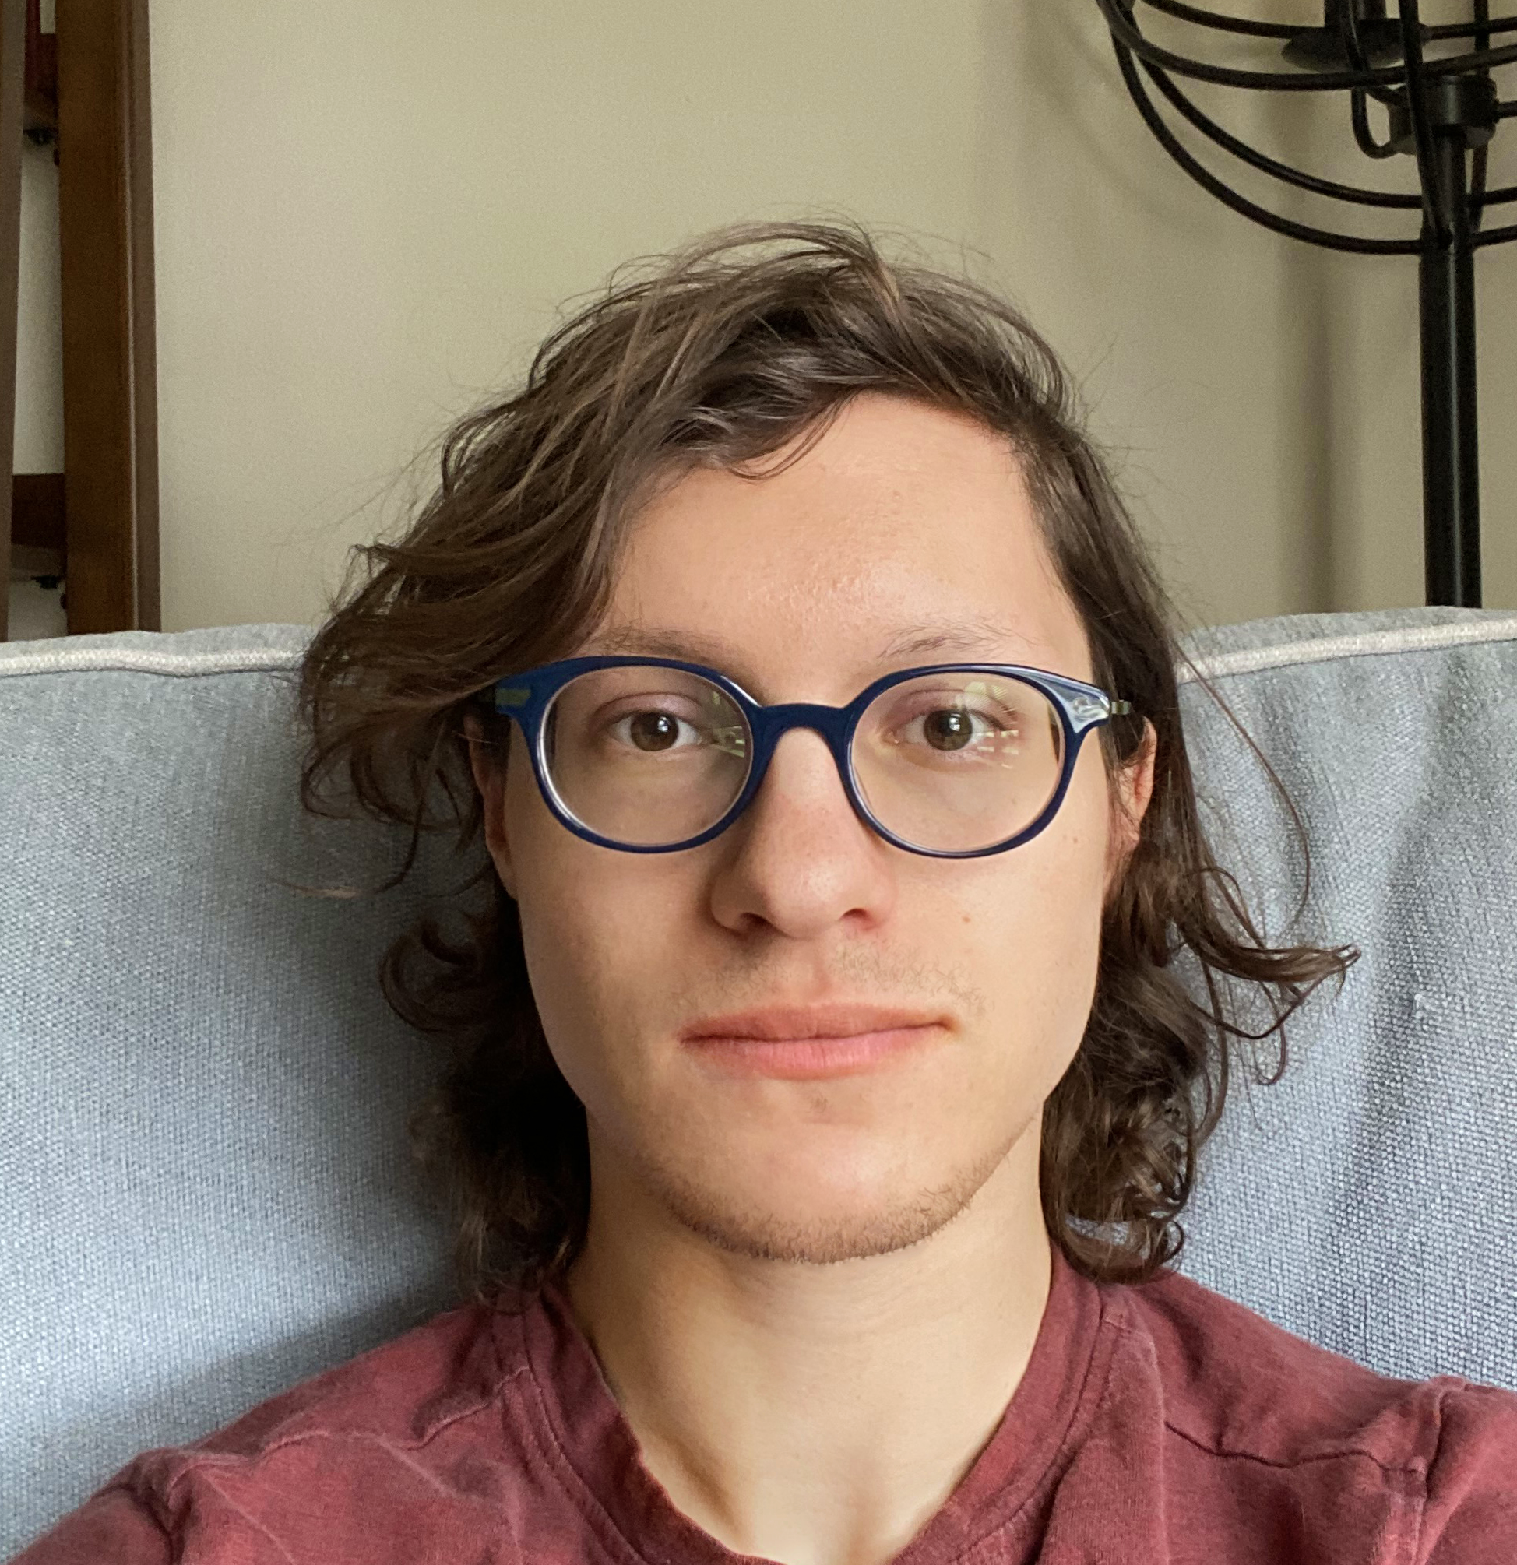
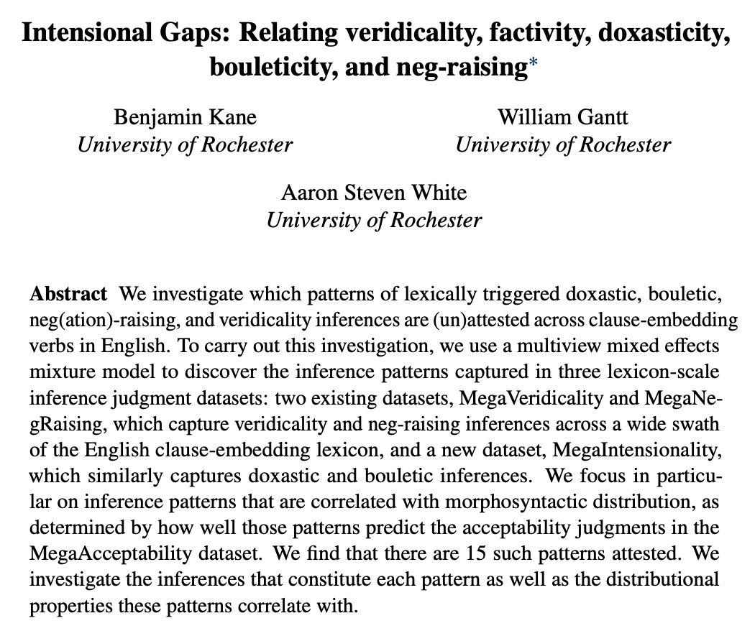
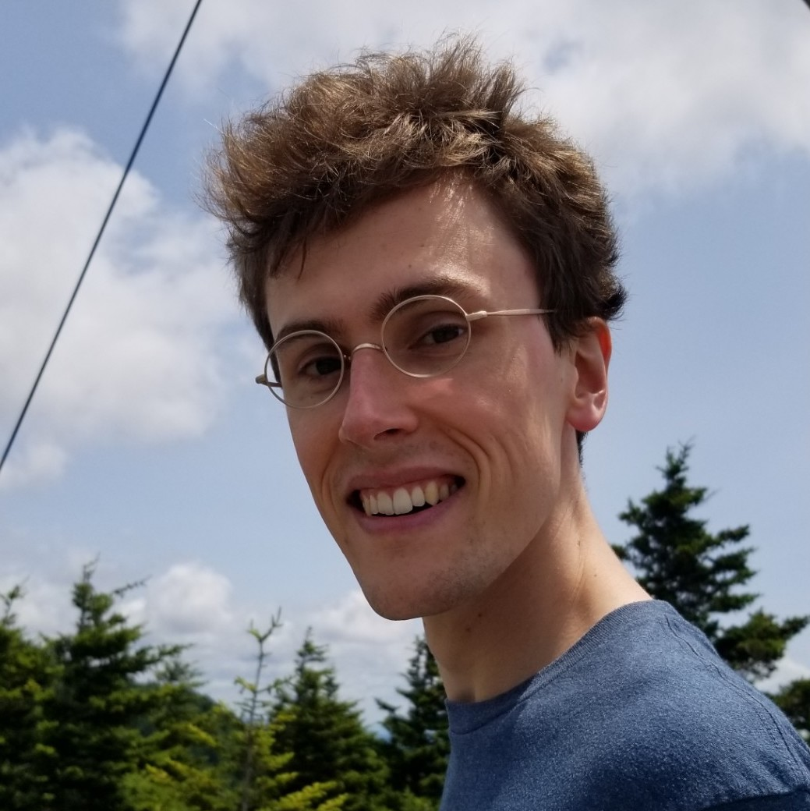
Ben Kane
OpenStream.AI
Will Walden
Johns Hopkins University

Slide 21
Entails belief-not
Backgrounds belief
very likely
NB: not a perfect measure of backgrounding belief, since we don’t measure belief inferences involving modalized contents.
A didn’t __ that C happened?
How likely is it that A believed that C happened?
Entails belief
very
unlikely
very likely
A __ed that C happened?
How likely is it that A believed that C happened?
Kane et al. 2022

Slide 22
Entails desire-not
Backgrounds desire
very likely
A didn’t __ that C happened?
How likely is it that A wanted C to have happened?
Entails desire
very
unlikely
very likely
A __ed that C happened?
How likely is it that A wanted C to have happened?
Kane et al. 2022

Slide 23
Entails desire or desire-not
r = 0.56
Backgrounds Belief

Slide 24
Challenge
How do we know what the relationship between measures should look like in any particular case?

Slide 25
Neg-raising
Factivity

Slide 26
Entails desire or desire-not
r = 0.56
Backgrounds Belief

Slide 27
Challenge
How do we know what the relationship between measures should look like in any particular case?
Upshot
Need a generic way to find where points do and do not occur across many different inferences simultaneously.

Slide 28
yes
???
Factives
Someone didn’t __ that a particular thing happened?
Did that thing happen?
Antiveridicals
Nonfactives
Veridicals
no
yes
Someone __ed that a particular thing happened?
Did that thing happen?
White & Rawlins 2018

Slide 29
Ben Kane
OpenStream.AI
Will Walden
Johns Hopkins University

Slide 30
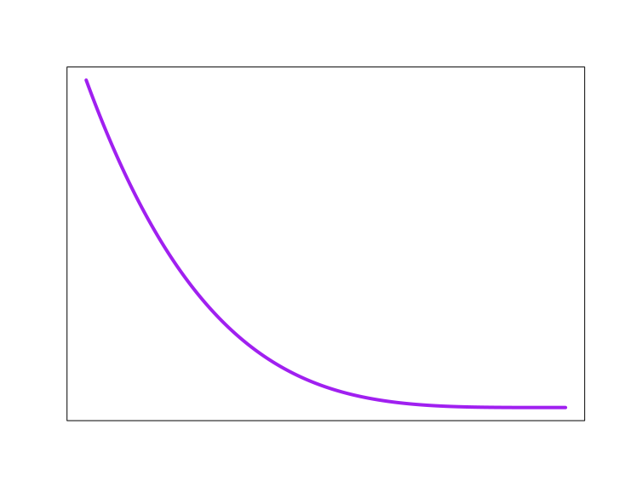
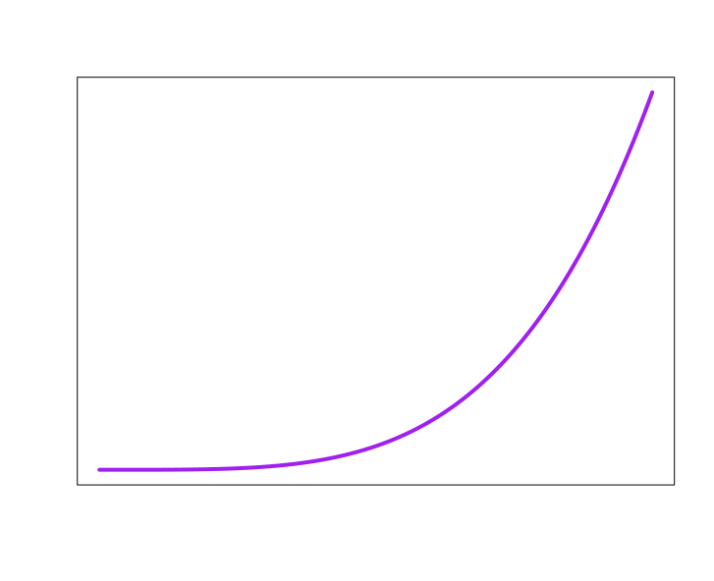
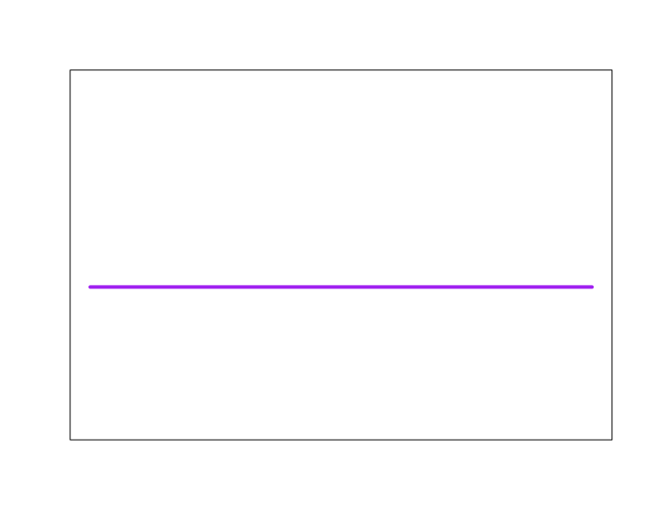
Probability of occurring in cluster
know
1
2
3
4
5
6
10
11
7
8
9
12
Neg-raising
Belief
Desire
Acceptability
Veridicality
NP[3s] not _ S
NP_ S
NP _ S
NP _ S
NP _ S
5
4
1
3
6
0
1
0
1
0
1
no
maybe
yes
2
7

Slide 31
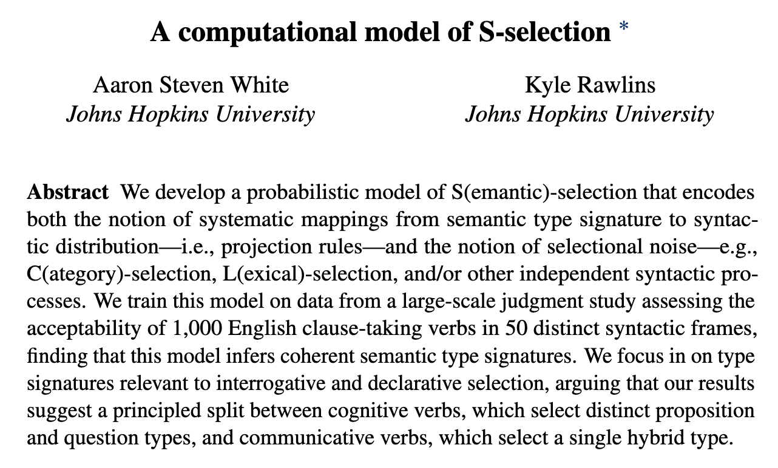
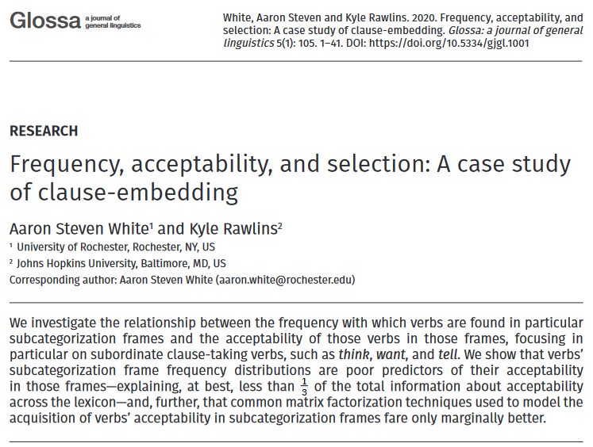
Kyle Rawlins
Johns Hopkins University

Slide 32
Probability of occurring in cluster
know
1
2
3
4
5
6
10
11
Important for ensuring the clusters are plausibly semantic
7
8
9
12
Neg-raising
Belief
Desire
Acceptability
Veridicality
NP[3s] not _ S
NP_ S
NP _ S
NP _ S
NP _ S
5
4
1
3
6
0
1
0
1
0
1
no
maybe
yes
2
7

Slide 33
Idea
Lexical semantic generalizations can be read off of the clusters’ distributions.

Slide 34
Probability of occurring in cluster
know
1
2
3
4
5
6
10
11
7
8
9
12
Neg-raising
Belief
Desire
Acceptability
Veridicality
NP[3s] not _ S
NP_ S
NP _ S
NP _ S
NP _ S
5
4
1
3
6
0
1
0
1
0
1
no
maybe
yes
2
7

Slide 35
Idea
Lexical semantic generalizations can be read off of the clusters’ distributions.
Example
No cluster that contains verbs that project desire but entail belief.

Slide 37
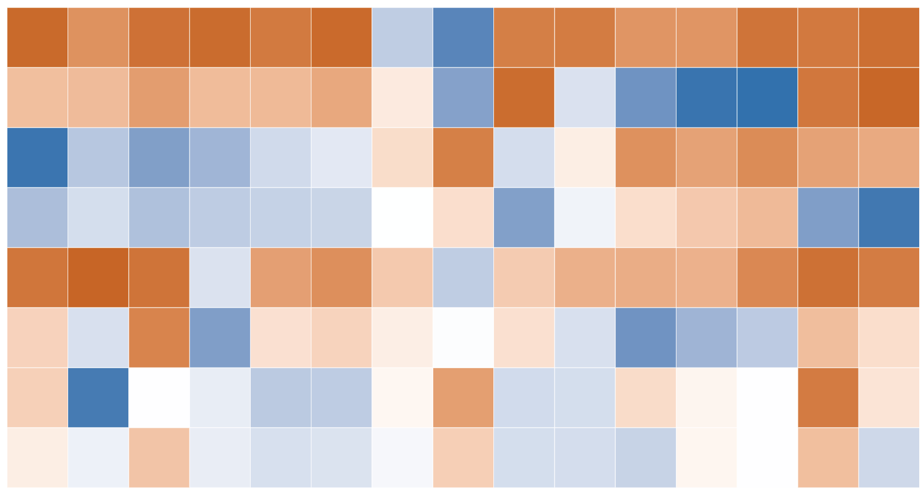
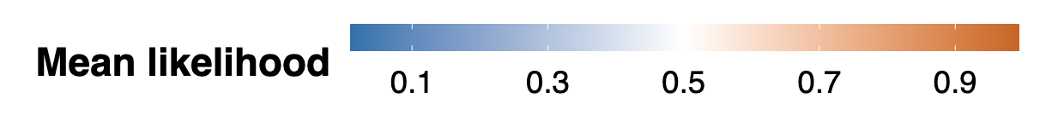
entails belief!
projects belief!
NP _ S -> NP believe S
NP not _ S -> NP believe S
Don’t see the inverse of this!
Inferences
NP _ S -> NP want S
NP not _ S -> NP want S
no desire!
entails desire!
Clusters

Slide 38
Challenge
While we can capture relationships among distributional and inferential properties, the model does not represent why those relationships hold.

Slide 39
⟦ love ⟧ = λp.λx.DOX(x, p): BOUL(x,p)
✓
⟦ schlove ⟧ = λp.λx.BOUL(x, p): DOX(x,p)
x
Notes:
For instance, the model finds that we have predicates like “love” and not predicates like “schlove”, but it doesn’t give us a reason. For instance, it doesn’t say that whatever component of the semantic value gives rise to the “want” inference isn’t allowed to go here in the semantic value.

Slide 40
Challenge
While we can capture relationships among distributional and inferential properties, the model does not represent why those relationships hold.
Reason
The model doesn’t represent how inferences are related to expressions’ form and lexical contents.
Notes:
And the reason for this is that the model doesn’t represent how inferences are related to expressions’ form and contents. This in turn prevents us from representing and evaluating lexical semantic constraints that posit such relationships.

Slide 41
Challenge
Want to cluster predicates’ semantic values to see how components combine, but we can’t see semantic values.
Idea
Let’s cluster predicates in terms of their semantic values anyway.
Notes:
Another way of viewing this challenge is this way: we want to cluster predicates’ semantic values because that would mean we could see where components are allowed to go and which components can cooccur, but we can’t see the components. So the main idea behind the framework I’m about to present is to say “let’s cluster predicates in terms of their semantic values anyway”

Slide 42
The Framework

Slide 43
Question
How could we cluster predicates in terms of their semantic values if we can’t see their semantic values.
Answer
Along with the clusters, we treat the semantic values as latent variables and search for good settings of them.

Slide 44
lexical_item := {love, know, say, …}
senses
senses(love) = {EMOT_FACT, ACQUAINT}
lexical_class
polysemy_class := P(lexical_class)
set
lexical_class := {COG_FACT, EMOT_FACT, …}
value
value(EMOT_FACT) = {BOUL, DOX, VER}
sem_component
sem_value := P(sem_component)
set
sem_component := {BOUL, DOX, VER, UTTER, …}
Notes:
So like the Kane et al. model, we’ll assume that lexical items fall into clusters, like cognitive factive and emotive factive. I’ll refer to these clusters as lexical classes and to sets of them as polysemy classes. I’m going to use this notation for powersets moving forward. One of our aims is then going to be to find a good setting of a function senses from lexical items to polysemy classes, where for instance, we might want senses to map love to a polysemy class including emotive factive and acquaintance love.
In addition to lexical and polysemy classes, we’ll add a notion of semantic component, like BOUL, DOX, etc. And we’ll assume that semantic values are sets of these semantic components. So another of our aims is going to be to find a good setting of a function value that maps us from lexical classes to semantic values. So for instance, value might map the lemotive factive class to the set BOUL, DOX, and VER.
I’m going to talk more in a second about how we capture generalizations around which components get backgrounded, which rely on a separate component of the system.

Slide 45
Question
What does it mean to be a good setting of senses and value?
Answer
They are part of programs that predict acceptability and inference judgment data well.
Notes:
Before I do that, I want to say a little more about what I mean by a good setting of the functions senses and value. Basically, what I’m going to mean is that they are part of some program that predicts acceptability and inference judgment data well.

Slide 46
…
senses
…
acceptable
inferable
…
value
…
…
…
…
NP _ that S NP believe S
NP _ that S
NP _ that S NP want S
love
+
NP _ whether S
NP not _ that S NP believe S
NP _ NP that S
NP not _ that S NP want S
Acceptability judgments
Inference judgments
Notes:
More specifically, given a predicate like “love”, some set of acceptability judgments and some set of inference judgments, we’ll define a function acceptable that takes predicates and syntactic contexts and uses senses and value, alongside some other functions, to predict the distribution of acceptability judgments. Analogously, we’ll define a function inferable that takes a predicate and an inference template and uses senses and value–again, alongside some other functions–to predict the distribution of inference judgments.

Slide 47
Question
How do we deal with gradience?
Answer
Model acceptable and inferable as probabilistic programs that feed response models.
Notes:
Okay. So how does this approach deal with the sort of gradience I said was so challenging? The basic idea is going to be that acceptable and inferable are going to be probabilistic programs that we compose with what I’ll refer to as a response model. The response model is effectively what is commonly referred to as a linking assumption.

Slide 48
…
senses
…
acceptable
inferable
…
value
…
…
…
…
response
model
0.95
NP _ that S NP believe S
NP _ that S
NP _ that S NP want S
love
+
NP _ whether S
NP not _ that S NP believe S
NP _ NP that S
NP not _ that S NP want S
Acceptability judgments
Inference judgments
Notes:
So basically, acceptable will output a probability–say, 0.95 for syntactic contexts a predicate is good in–and pipe this into the response model, which is what produces the distribution. And the same will be true for inferable.

Slide 49
Implementation
Specify a family of probabilistic programs consisting of definable functions.

Slide 50
B
sum = 1
sum = 1
sum = 1
f: A -> B
A
sum = 1
sum = 1
sum = 1
sum ∈ [0, |B|]
sum ∈ [0, |B|]
sum ∈ [0, |B|]
A
B
sum ∈ [0, |B|]
f: A -> P(B)
set
sum ∈ [0, |B|]
sum ∈ [0, |B|]

Slide 51
Implementation
Specify a family of probabilistic programs consisting of definable functions.
Find program that best explains judgment distributions when combined with a response model.

Slide 52
Defining acceptable
Fitting acceptable
The architecture of the acceptability model.
How well does the acceptability model fit to acc. judgments.
Fitting inferable
Defining inferable
How well does the acceptability model fit to acc. judgments.
The architecture of the inference model.

Slide 53
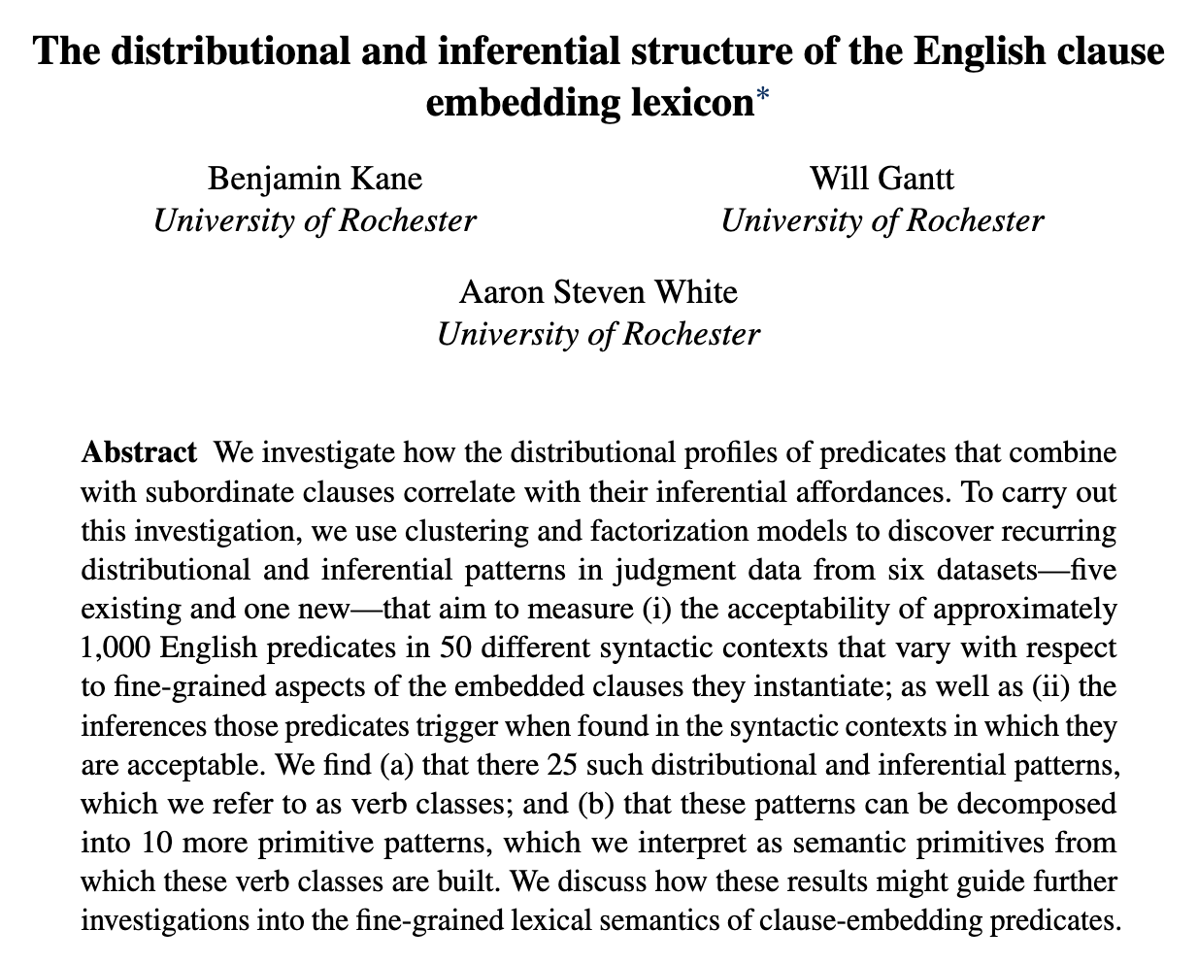
In preparation!
Ben Kane
OpenStream.AI
Will Gantt
Johns Hopkins University
Notes:
One thing I want to mention briefly before moving on is to say that I’ll be training on all the inference and acceptability judgment data I’ve mentioned so far, as well as some unreleased data we report on in this paper in preparation, which looks at belief, desire, and intention inferences when predicates are found in nonfinite contexts. This will be important when we get to talking about generalization, because one of them involves intention inferences.

Slide 54
The Framework Defining acceptable

Slide 55
lexical_item
syn_type_signature :=
acceptable
complex_syn_type
set
complex_syn_type
prim_syn_type
:= prim_syn_type*
string
NP _ that S
love
+
NP _ whether S
NP _ NP that S
Acceptability judgments

Slide 56
lexical_item
lexical_class
sem_component
set
set
polysemy_class
sem_value
senses
value
acceptable
???
prim_syn_type
string
complex_syn_type
set
sem_type_signature

Slide 57
lexical_item
lexical_class
sem_component
set
set
polysemy_class
sem_value
senses
value
complex_sem_type
set
sem_type_signature
prim_syn_type
string
complex_syn_type
set
sem_type_signature

Slide 58
lexical_item
lexical_class
sem_component
set
set
polysemy_class
sem_value
select
senses
value
prim_sem_type
string
complex_sem_type
set
sem_type_signature
⟦ love ⟧ = λp.λx.DOX(x,p): BOUL(x,p)
project
prim_syn_type
E _ P
<<s, t>, <e, t>>
string
complex_syn_type
set
NP _ S
sem_type_signature

Slide 59
lexical_item
lexical_class
sem_component
set
set
polysemy_class
sem_value
select
senses
value
prim_sem_type
string
complex_sem_type
set
sem_type_signature
realize
⟦ love ⟧ = λp.λx.DOX(x,p): BOUL(x,p)
set
prim_syn_type
E _ P
<<s, t>, <e, t>>
string
complex_syn_type
set
NP _ S
sem_type_signature

Slide 60
lexical_item
lexical_class
sem_component
set
set
polysemy_class
sem_value
select
senses
value
prim_sem_type
string
complex_sem_type
set
sem_type_signature
signatures
realize
⟦ love ⟧ = λp.λx.DOX(x,p): BOUL(x,p)
set
prim_syn_type
E _ P
<<s, t>, <e, t>>
string
complex_syn_type
set
NP _ S
sem_type_signature

Slide 61
The Framework Fitting acceptable

Slide 62
Procedure
Given hyperparams |prim_sem_type|, |lexical_class|, |sem_component|, fit to acceptability and inference data.
Model selection
Hold out 10% of data, fit to other 90%, select best setting of hyperparams based on prediction of held-out data.

Slide 63
Result #1
Model predicts held-out acceptabiliy judgments as well as humans agree with each other.
Upshot
It’s worth looking at how this model explains the data.
Notes:
By interpretable, I mean there is some way to look at the hypotheses that the model encodes and read generalizations off of them.

Slide 64
The Framework Defining inferable

Slide 65
lexical_item
syn_type_signature :=
acceptable
complex_syn_type
set
complex_syn_type
prim_syn_type
:= prim_syn_type*
string
NP _ that S
love
+
NP _ whether S
NP _ NP that S
Acceptability judgments

Slide 66
lexical_item
expression := lexical_item x operator x complex_syn_type
operator
complex_syn_type
prim_syn_type
:= prim_syn_type*
string
NP _ that S NP believe S
NP _ that S
NP _ that S NP want S
love
+
NP _ whether S
NP not _ that S NP believe S
NP _ NP that S
NP not _ that S NP want S
Acceptability judgments
Inference judgments

Slide 67
lexical_item
lexical_class
sem_component
set
set
polysemy_class
sem_value
select
senses
value
prim_sem_type
string
complex_sem_type
set
sem_type_signature
signatures
realize
⟦ love ⟧ = λp.λx.DOX(x,p): BOUL(x,p)
set
prim_syn_type
E _ P
<<s, t>, <e, t>>
string
complex_syn_type
set
NP _ S
sem_type_signature

Slide 68
lexical_item
lexical_class
sem_component
set
set
polysemy_class
sem_value
senses
value
⟦ love ⟧ = λp.λx.DOX(x,p): BOUL(x,p)
E _ P
<<s, t>, <e, t>>
NP _ S

Slide 69
lexical_item
lexical_class
sem_component
set
set
polysemy_class
sem_value
set
senses
value
realize
core_val
⟦ love ⟧ = λp.λx.DOX(x,p): BOUL(x,p)
E _ P
<<s, t>, <e, t>>
expression
NP _ S

Slide 70
apply
lexical_item
lexical_class
sem_component
set
set
polysemy_class
sem_value
set
senses
value
core_val
⟦NP love S⟧ = DOX(⟦NP⟧, ⟦S⟧): BOUL(⟦NP⟧, ⟦S⟧)
not
expression
DOX(⟦NP⟧, ⟦S⟧): ~BOUL(⟦NP⟧, ⟦S⟧)

Slide 71
apply
lexical_item
lexical_class
sem_component
set
set
polysemy_class
sem_value
set
senses
value
prove
core_val
⟦NP love S⟧ = DOX(⟦NP⟧, ⟦S⟧): BOUL(⟦NP⟧, ⟦S⟧)
expression
⟦NP want S⟧ = BOUL(x,p)

Slide 72
The Framework Fitting inferable

Slide 73
Setting #1: Pipeline
Fit acceptability model to acceptability data, then fixing acceptability model, fit inference model to inference data.
Setting #2: Joint
Fit acceptability model to acceptability data, then fit both acceptability and inference model to inference data.
Notes:
By interpretable, I mean there is some way to look at the hypotheses that the model encodes and read generalizations off of them.

Slide 74
Result #2
Under pipelined approach, model predicts held-out belief/desire judgments (but not veridicality and neg-raising judgments) nearly as well as humans agree w/ each other.
Upshot
Veridicality/neg-raising does not seem to have as cohesive a distributional profile as classes triggering belief/desire.
Notes:
By interpretable, I mean there is some way to look at the hypotheses that the model encodes and read generalizations off of them.

Slide 75
Result #3
Under joint approach, model predicts predicts all inference judgments as well as humans agree with each other, but at the cost of slightly degraded acceptability prediction.
Upshot
Model reaches observational adequacy for inference judgments at a small cost to adequacy for acc. judgments

Slide 76
Some Generalizations

Slide 77
Question
How do we extract generalizations?
Answer
Specify target inference templates T and search over generalizations of the form [∧_{i∈I} t_{i}(c)] → [∧_{j∈J} t_{j}(c)] for all c ∈ lexical_class.
Notes:
By interpretable, I mean there is some way to look at the hypotheses that the model encodes and read generalizations off of them.

Slide 78
Description Type #1 (Unrepresentability)
Semantic components available for building semantic values are constrained to support certain kinds of inferences.
Notes:
By interpretable, I mean there is some way to look at the hypotheses that the model encodes and read generalizations off of them.

Slide 79
Generalization #1
Antiveridicality inferences never project.
Notes:
By interpretable, I mean there is some way to look at the hypotheses that the model encodes and read generalizations off of them.

Slide 80
~p <- ~V(p) -> p
~p <- V(p) -> p
Notes:
No semantic component that (i) gives rise to antiveridicality inferences; and (ii) negation does not affect.

Slide 81
Generalization #1
Antiveridicality inferences never project.
Model Explanation #1
There is no semantic component that (i) is not modified by negation; and (ii) that is sufficient for antiveridicality.

Slide 82
Description Type #1 (Unrepresentability)
Semantic components available for building semantic values are constrained to support certain kinds of inferences.
Description Type #2 (Regular Polysemy)
When a predicate has a sense in one lexical class it will always have a sense in another lexical class.
Notes:
By interpretable, I mean there is some way to look at the hypotheses that the model encodes and read generalizations off of them.

Slide 83
Generalization #2
When a negated nonfinite-taking predicate triggers intention inferences, it triggers belief inferences when taking a finite.
Model Explanation #2
Nonfinite+finite-taking predicates all fall into ≥2 classes, but observed class pairings are a subset of all possible pairings.
Notes:
By interpretable, I mean there is some way to look at the hypotheses that the model encodes and read generalizations off of them.

Slide 84
~intend(p_{nonfinite}) <- ~V(p_{nonfinite}) -> intend(p_{nonfinite})
~believe(p_{finite}) <- ~V(p_{finite}) -> believe(p_{finite})

Slide 85
Descriptive Adequacy

Slide 86
Question
How do we use this model to move beyond observational adequacy toward descriptive adequacy?
Idea
Impose constraints on functions, fit to data under those constraints, compare constrained v. unconstrained fits.

Slide 87
B
sum = 1
sum = 1
sum = 1
f: A -> B
A
sum = 1
sum = 1
sum = 1
sum ∈ [0, |B|]
sum ∈ [0, |B|]
sum ∈ [0, |B|]
A
B
sum ∈ [0, |B|]
f: A -> P(B)
set
sum ∈ [0, |B|]
sum ∈ [0, |B|]

Slide 88
Description Type #1 (Unrepresentability)
Semantic components available for building semantic values are constrained to support certain kinds of inferences.
Notes:
By interpretable, I mean there is some way to look at the hypotheses that the model encodes and read generalizations off of them.

Slide 89
Generalization #1
Antiveridicality inferences never project.
Model Explanation #1
There is no semantic component that (i) is not modified by negation; and (ii) that is sufficient for antiveridicality.

Slide 90
Description Type #1 (Unrepresentability)
Semantic components available for building semantic values are constrained to support certain kinds of inferences.
Example Constraint
apply(not, core_lf(_, S)) ∉ prove(V)
for all V ⊆ sem_value
Notes:
By interpretable, I mean there is some way to look at the hypotheses that the model encodes and read generalizations off of them.

Slide 91
Generalization #2
When a negated predicate takes a nonfinite, its veridicality inferences are no more positive than when it takes a finite.
Model Explanation #2
Nonfinite+finite-taking predicates all fall into ≥2 classes, but observed class pairings are a subset of all possible pairings.
Notes:
By interpretable, I mean there is some way to look at the hypotheses that the model encodes and read generalizations off of them.

Slide 92
Description Type #2 (Regular Polysemy)
Subsets of lexical classes a predicate can fall into are (at least) pairwise constrained.
Example Constraint
believe_lf = core_lf(believe, NP _ that S)
intend_lf = core_lf(intend, NP _ to VP))
if NP_ that S ∈ acceptable(pred) and NP_ to VP ∈ acceptable(pred)
if intend_lf ∈ prove(apply(not)(core_lf(pred, NP_ to VP)))
then believe_lf ∈ prove(apply(not)(core_lf(pred, NP_ that S)))
for all pred ∈ lexical_item
Notes:
By interpretable, I mean there is some way to look at the hypotheses that the model encodes and read generalizations off of them.

Slide 93
Limitation
We cannot currently directly specify anything about the internal structure of semantic components, so we can’t directly evaluate constraints on them.
Potential Remedy
In the same way semantic values were composed, semantic components could be.
Notes:
It is worth noting that there is still often a way of simulating

Slide 94
Conclusion

Slide 95
Lexical semantic constraints
Descriptive adequacy
evidence for
Lexical semantic generalizations
Notes:
To discover lexical semantic constraints, like “determiners must be conservative”, we use lexical semantic generalizations, like “all determiners are conservative”, as evidence, with the ultimate aim of obtaining a descriptively adequate lexical semantic theory: a theory that explains why the lexical semantic generalization–or hopefully some collection of such generalizations–holds.

Slide 96
Lexical semantic constraints
Descriptive adequacy
evidence for
Lexical semantic generalizations
Observational adequacy
Observational adequacy
evidence for
Acceptability, felicity, naturalness, … judgments
Inference judgments
Challenging to achieve when the relevant area of lexicon is large/open
Notes:
To discover lexical semantic generalizations, we need to synthesize evidence from acceptability, felicity, and naturalness judgments on the one hand, and inference judgments on the other, with the aim of obtaining an observationally adequate description of the data. Deriving observationally adequate lexical semantic generalizations turns out to be quite challenging to achieve when we move to larger and larger subsets of the lexicon for a variety of reasons I’ll discuss in a second.

Slide 97
Lexical semantic constraints
Goal 2
evidence for
Lexical semantic generalizations
Goal 1
evidence for
Acceptability, felicity, naturalness, … judgments
Inference judgments
Notes:
My goal in this talk is to meet these challenges by developing a modeling framework that can be used to automatically discover observationally adequate lexical semantic generalizations by synthesizing large acceptability and inference judgment datasets and that is expressive enough to state and quantitatively compare lexical semantic constraints as a means to reaching descriptively adequate theories.

Slide 98
Question #1
How do we integrate acceptability and inference judgment data from multiple languages into this framework?
e.g. Özyıldız et al. 2023
Idea
Add language-specific objects to lexical_item and prim_syn_type and but use shared semantic objects.

Slide 99
Question #2
How might we model non-semantic (e.g. pragmatic) drivers of different kinds of inferences.
Idea
Grove and White 2025a,b,c
Integrate this framework with the Probabilistic Dynamic Semantics, which supports a wide variety of models of formal pragmatics.

Slide 100
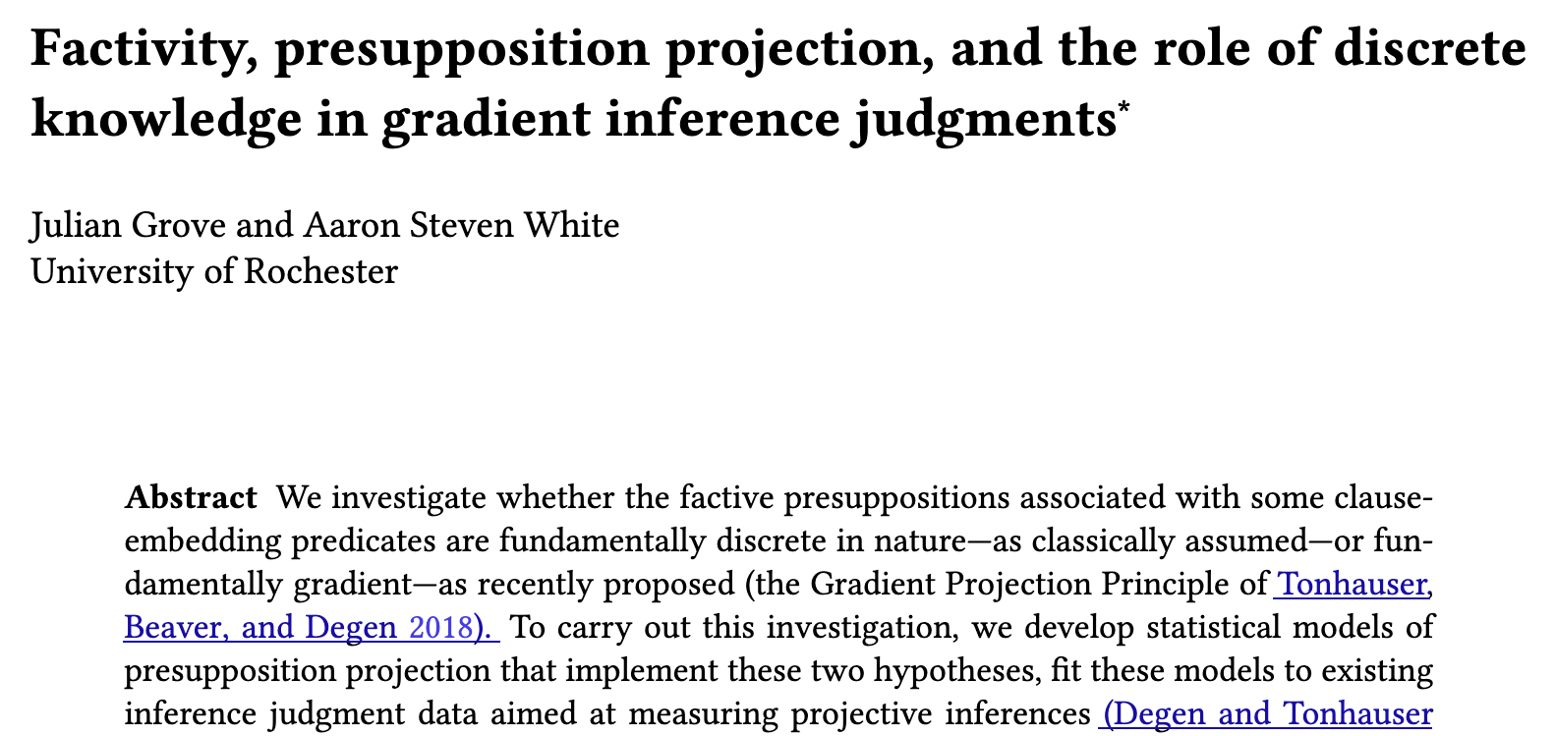
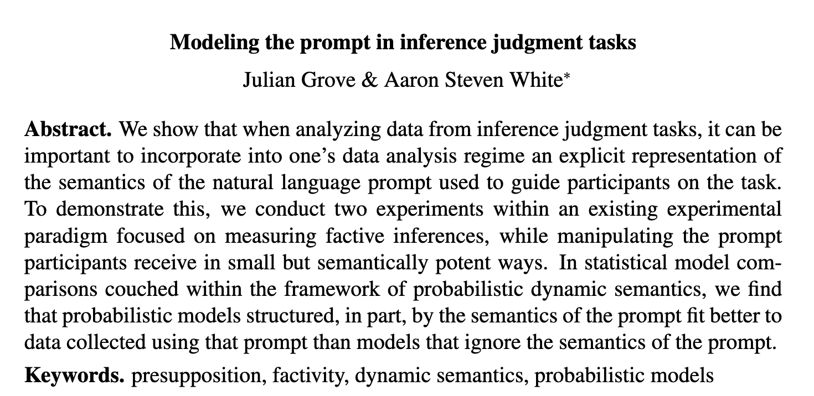
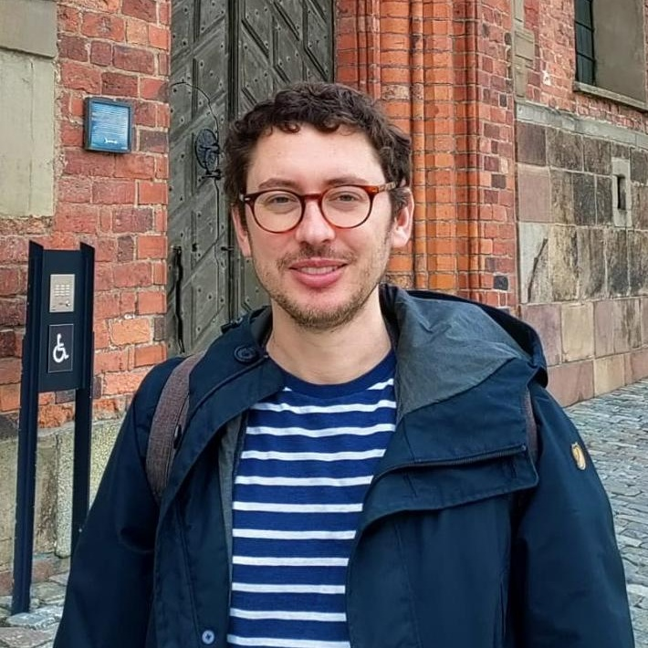
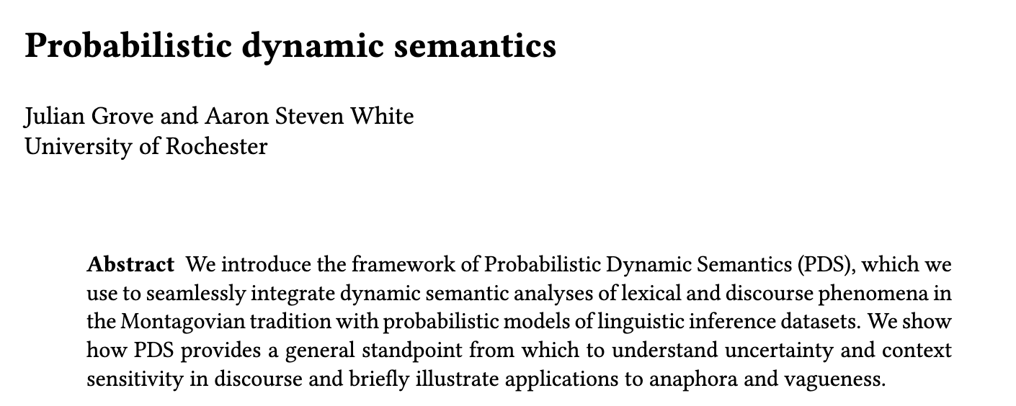
Julian Grove
University of Rochester

Slide 101
Question #3
Hacquard 2014, Dudley et al. 2015, 2018, Harrigan 2015, Dudley 2017, Hacquard and Lidz 2018, 2022
How can this framework be used to develop syntactic bootstrapping-based models of word learning?
Idea
White 2015, Hacquard and Lidz 2018, 2022, White et al. 2017, Huang et al. 2022
This framework directly elaborates existing models of syntactic bootstrapping and could be used as a drop-in replacement for them.

Slide 102
Thanks!

Slide 103

Supported by NSF-BCS-1748969
The MegaAttitude Project: Investigating selection and polysemy at the scale of the lexicon

Slide 104
Appendix A
Acceptability Judgments

Slide 105
Kyle Rawlins
Johns Hopkins University

Slide 106
MegaAcceptability Dataset
Acceptability for 1,000 verbs in 50 syntactic frames focused on clause-embedding.

Slide 107
Verbs
think
know
wonder
love
surprise
tell
say
start
stop
...

Slide 108
Bleaching Method
Frame templates (e.g. NP __ that S) instantiated by semantically bleached fillers.

Slide 109
Verbs
Frames
think
Someone __ed something happened
know
Someone __ed that something happened
wonder
Someone __ed whether something happened
love
Someone __ed which someone something happened
x
surprise
Someone __ed someone that something happened
tell
Someone __ed someone whether something happened
say
Someone __ed to someone that something happened
start
Someone __ed to do something
stop
Someone __ed someone to do something
...
...

Slide 110
MegaAcceptability Dataset
Acceptability for 1,000 verbs in 50 syntactic frames focused on clause-embedding.
50,000 total items x 5 judgments per item

Slide 111
Question
Is bleaching a valid method for capturing the acceptability of a verb in a frame?

Slide 112
Validation Strategy #1
Compare judgments for bleached items against judgments from trained linguists.
Validation Strategy #2
Assess generalization drawn from linguist hand-coding of acceptability across many predicates.

Slide 113
Validation data
Select 30 verbs from across Hacquard & Wellwood's (2012) classification
Gather judgments for these verbs in all 50 syntactic frames from:
trained linguists
naïve speakers

Slide 114
Comparison
Correlation between judgments from LI and Sprouse et al.'s (2013) dataset

Slide 115
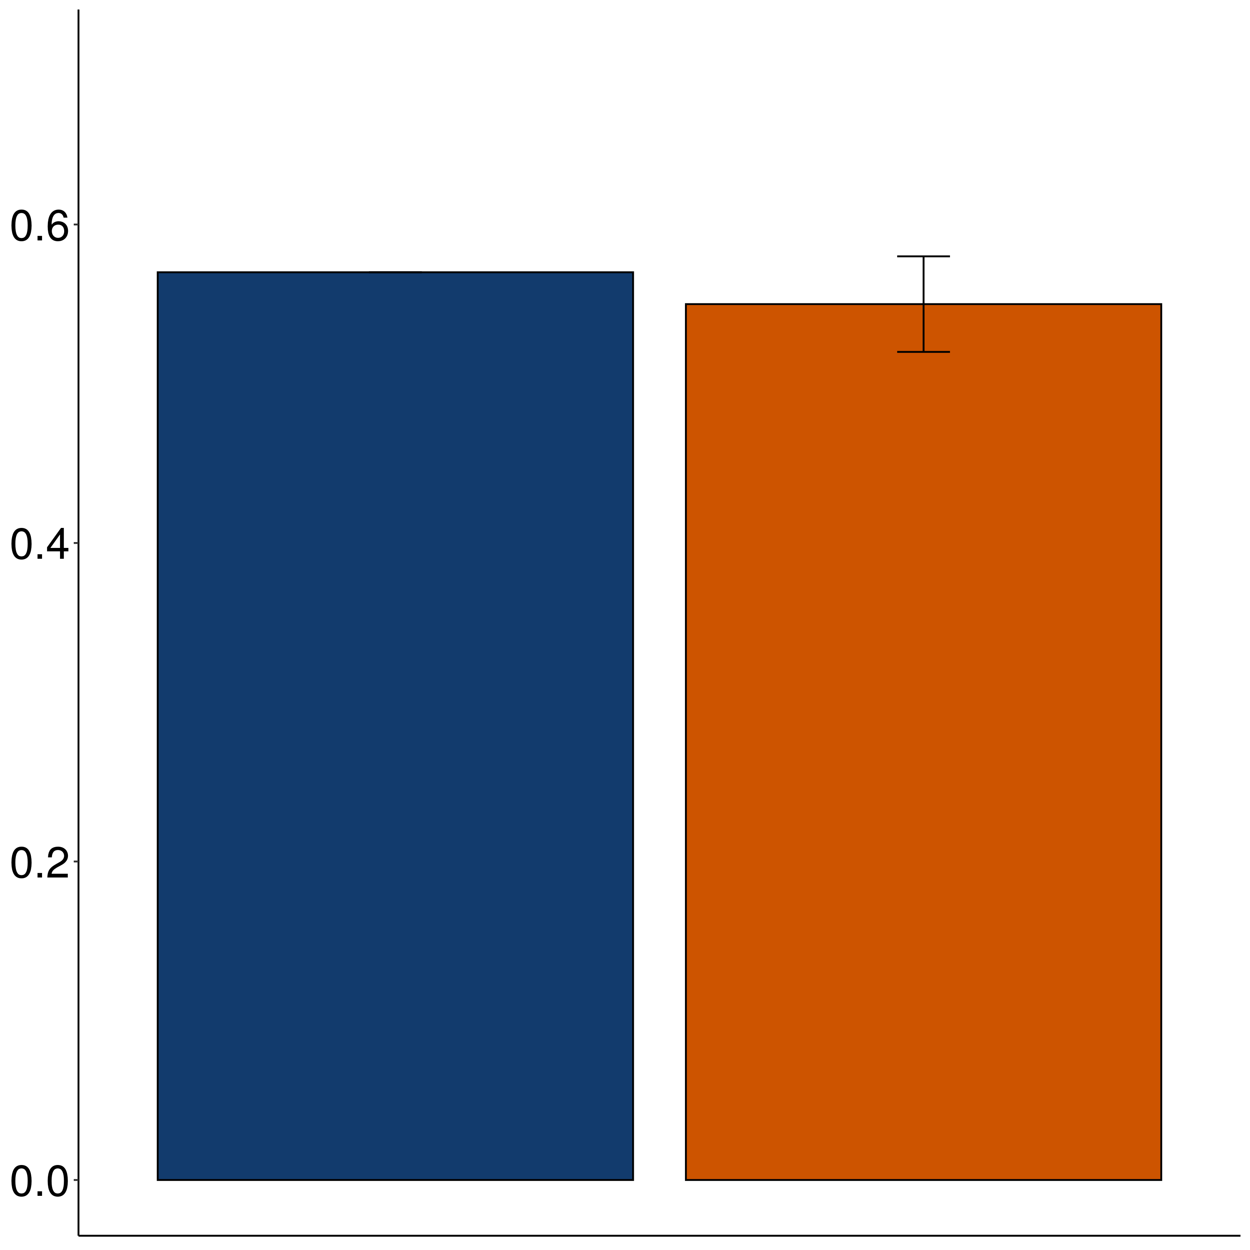
Correlation
Sprouse Linguistic Inquiry
MegaAcceptability

Slide 116
Case Study The vast majority of about-PPs are adjuncts.
Rawlins 2013, 2014

Slide 117
XP₁ V (XP₂) (XP₃) about XP₄
is acceptable
X
XP₁ V (XP₂) (XP₃)
is acceptable

Slide 118
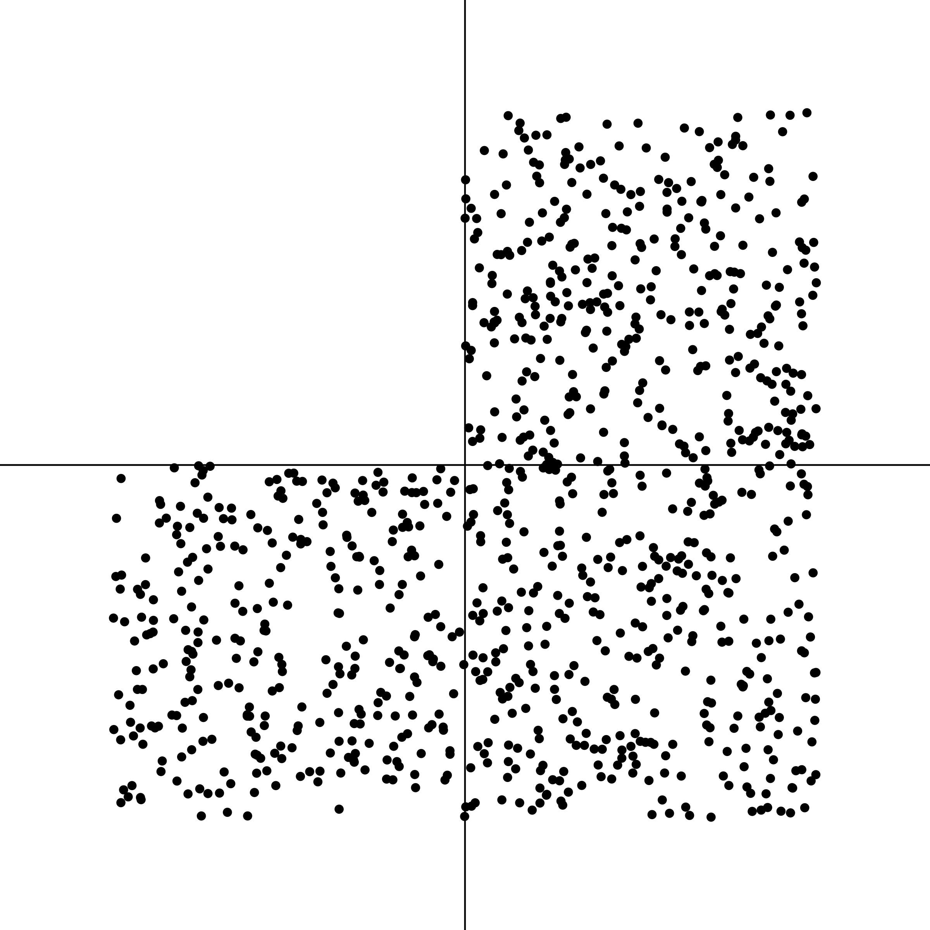

NP _ed about XP
NP _ed

Slide 119
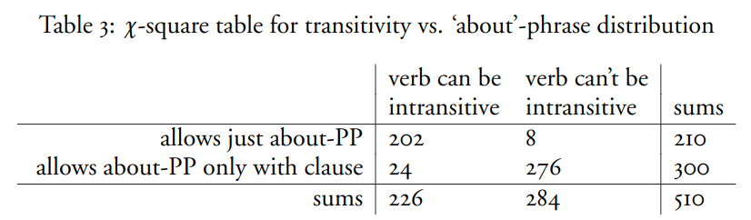
Rawlins 2014

Slide 120
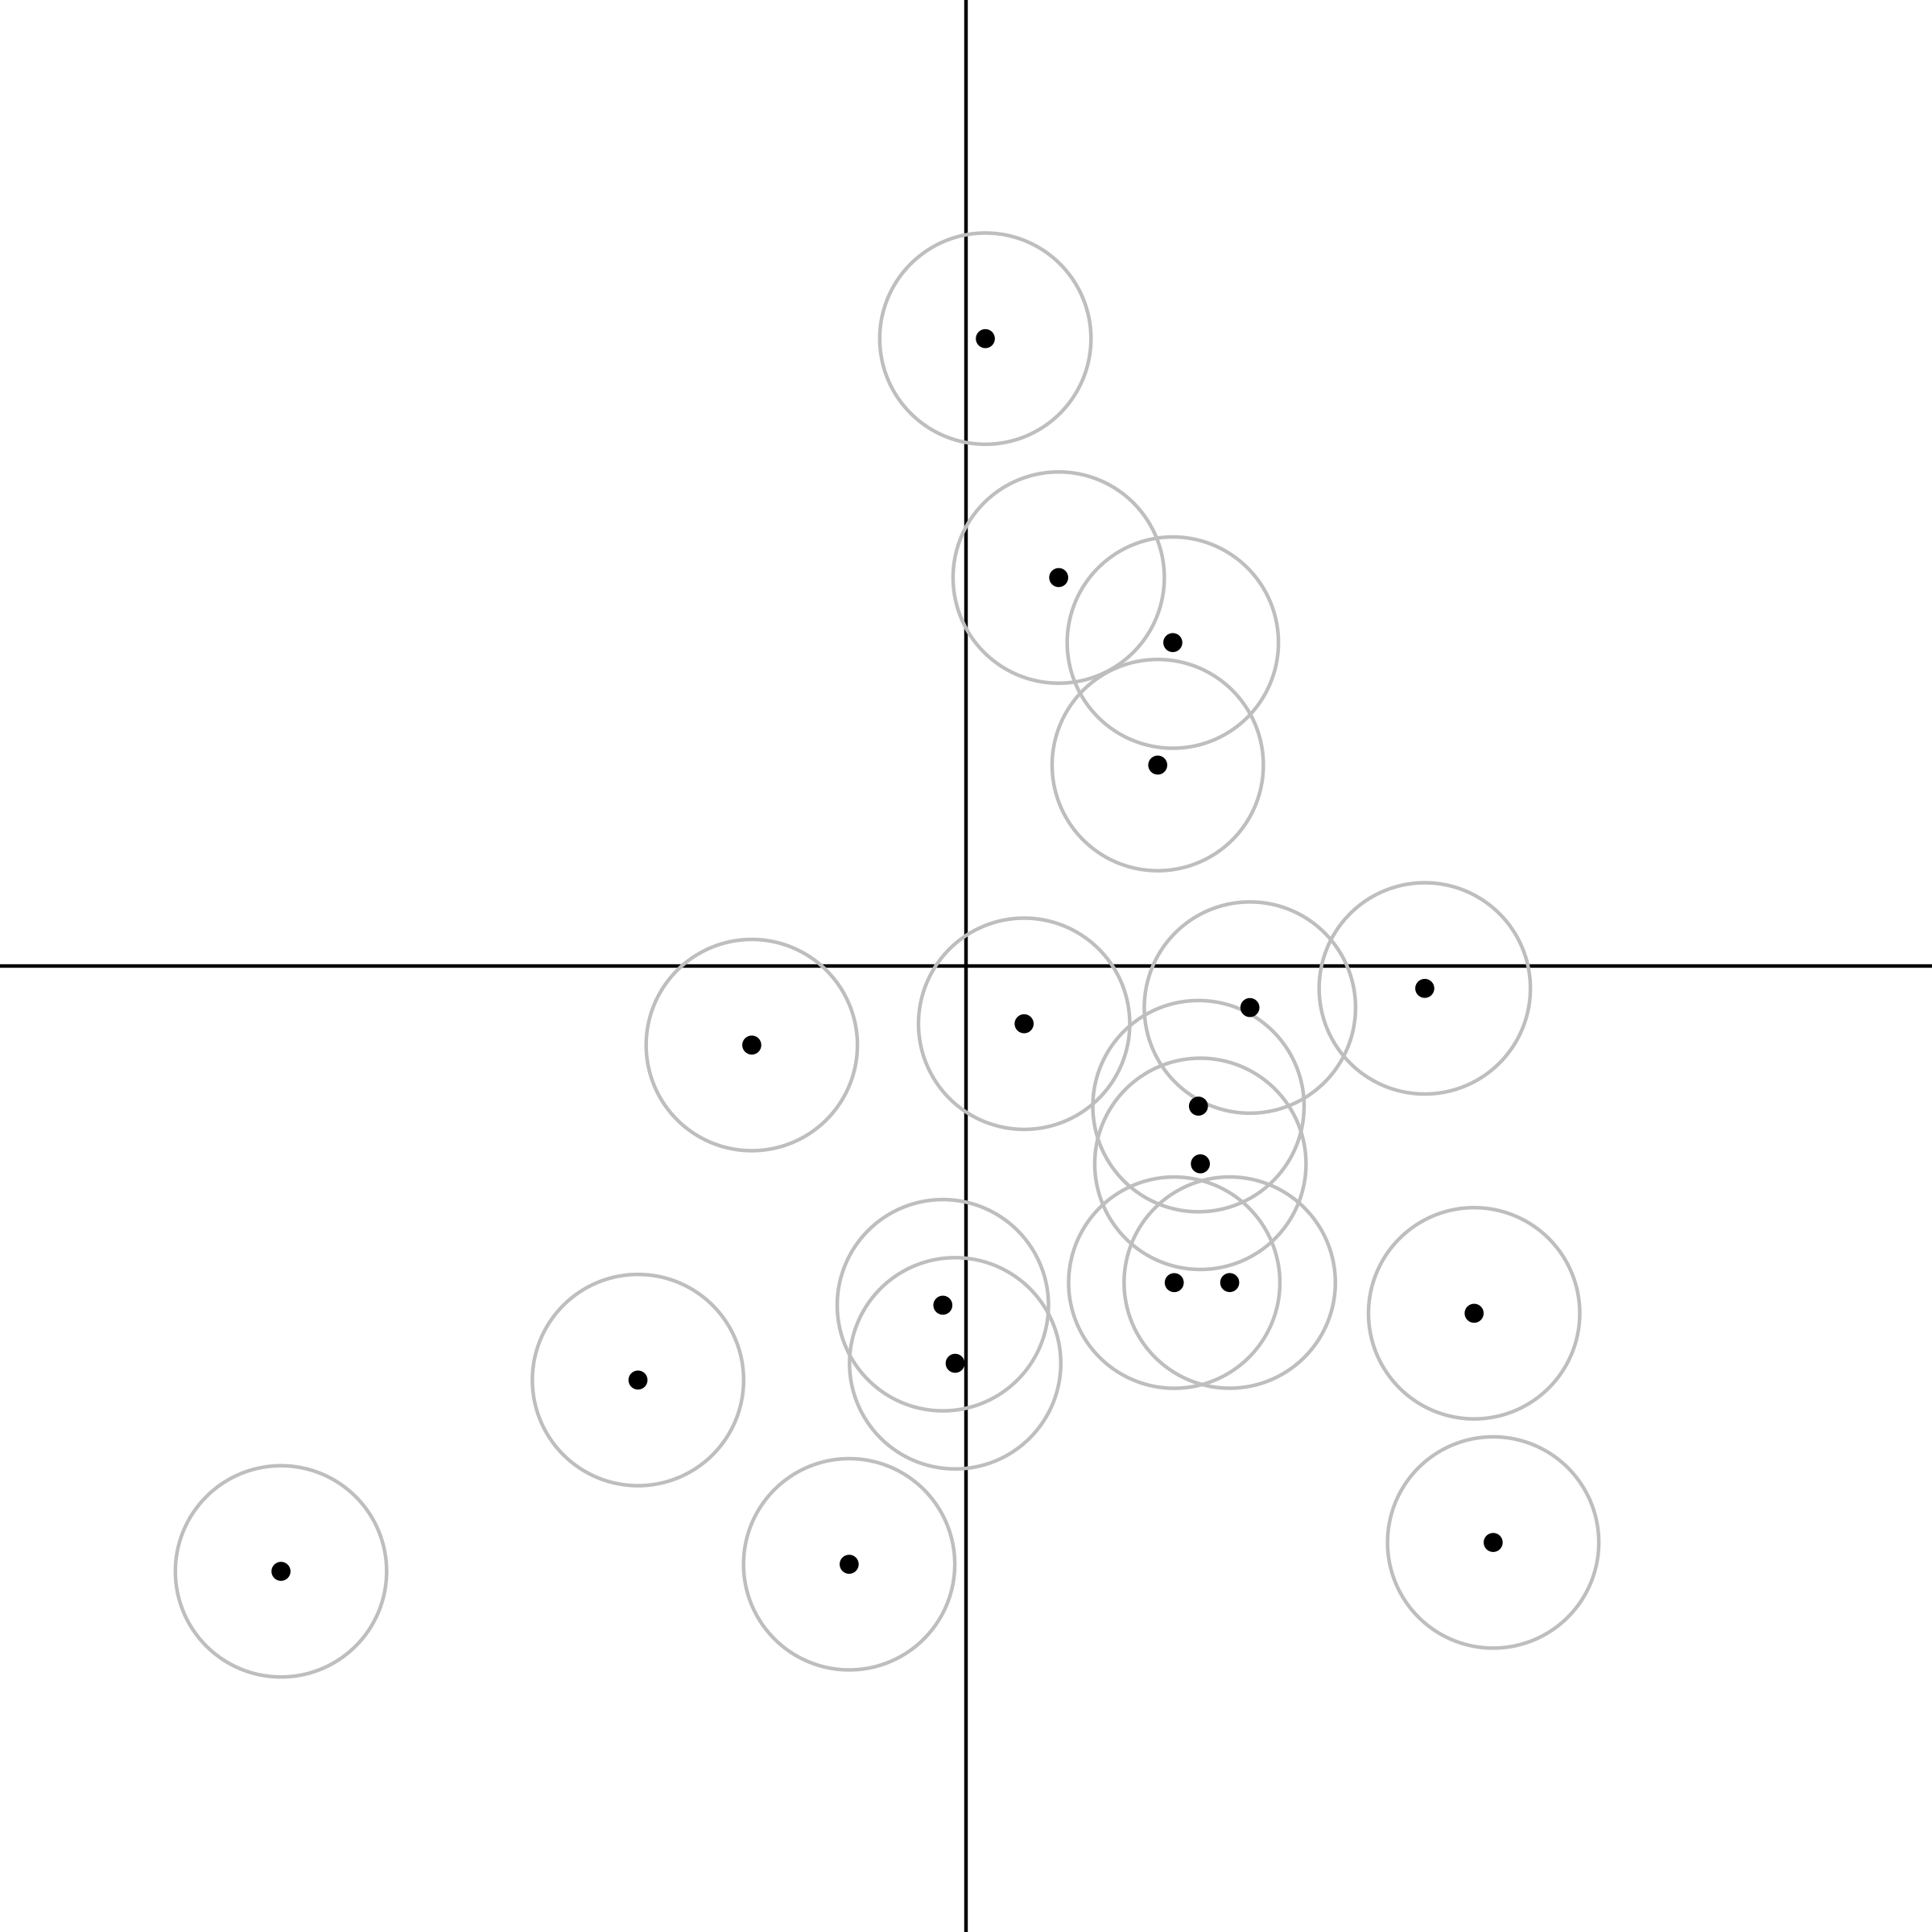
NP _ed about XP
NP _ed

Slide 121
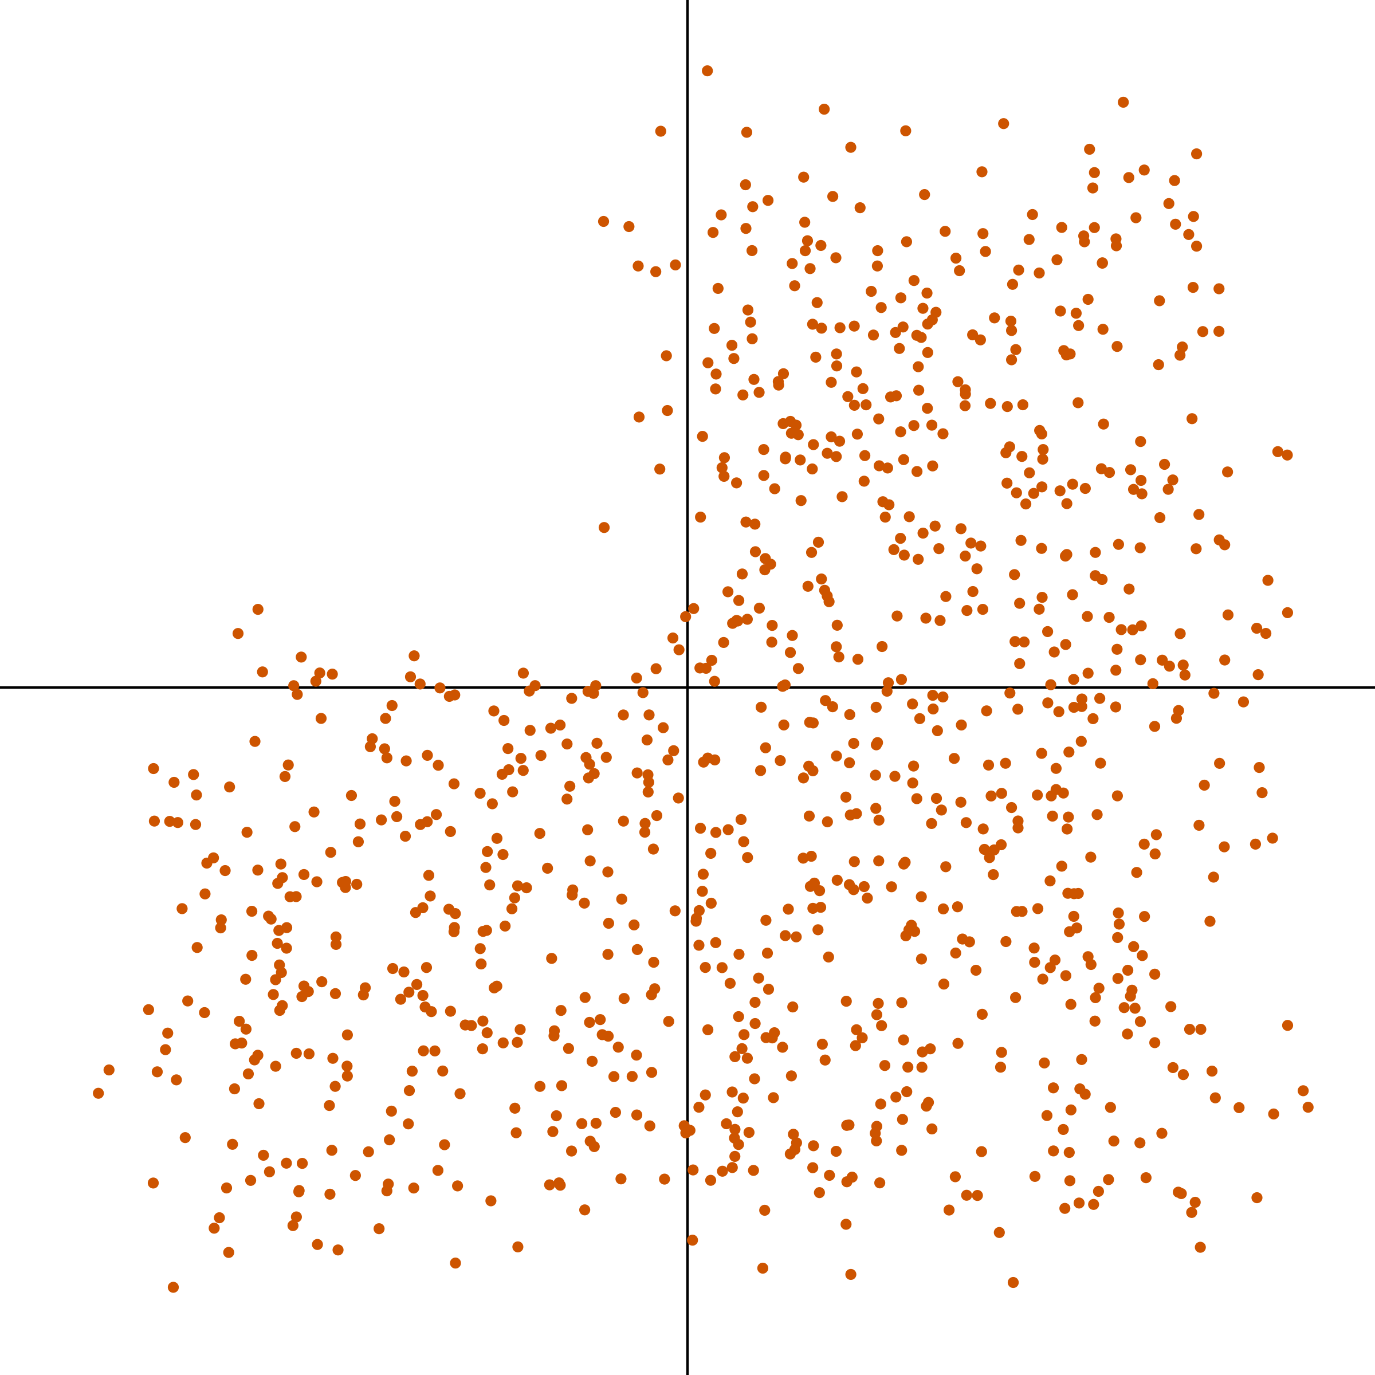
NP _ed about XP
NP _ed

Slide 122
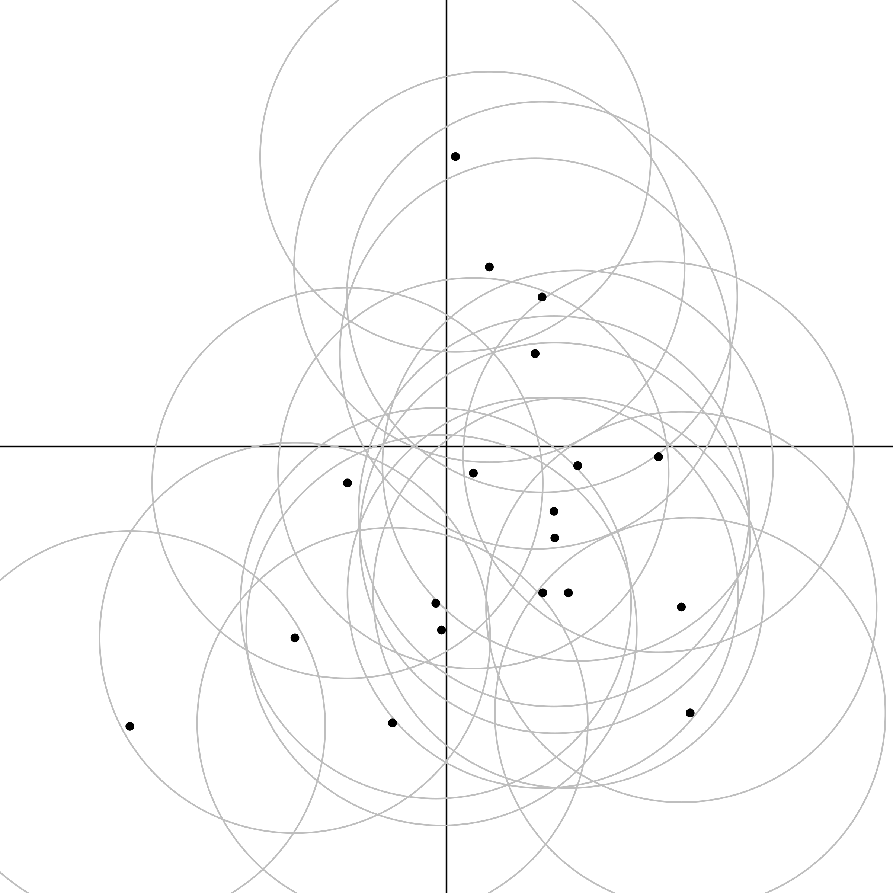
NP _ed about XP
NP _ed

Slide 123
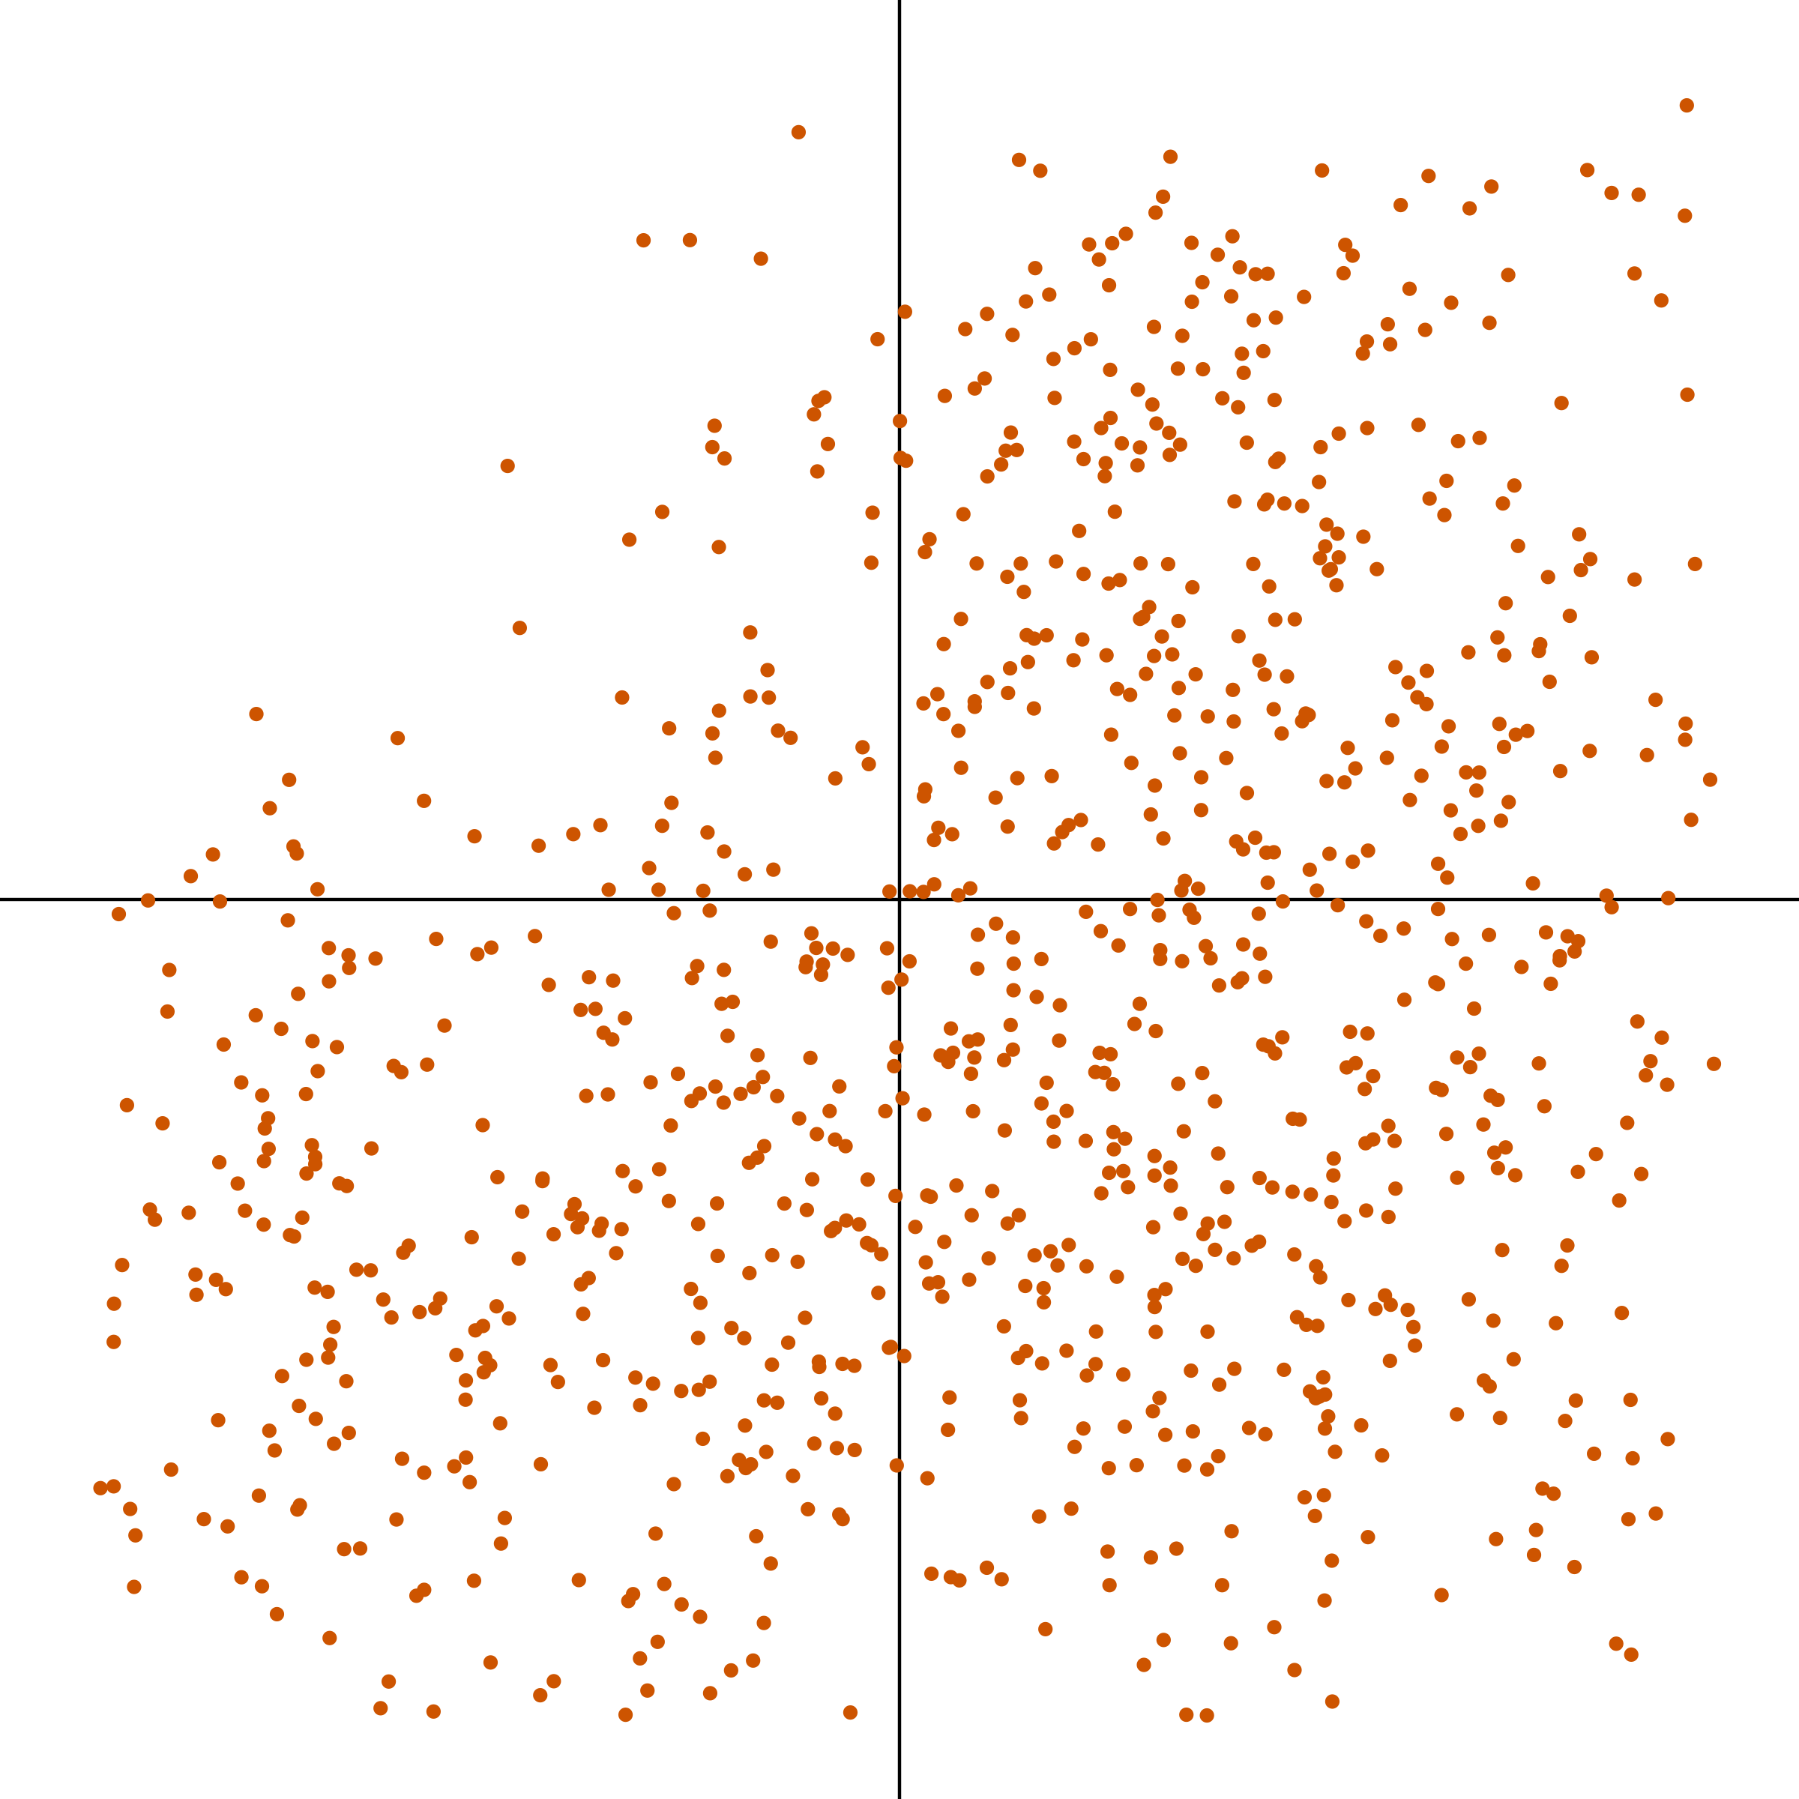
NP _ed about XP
NP _ed

Slide 124
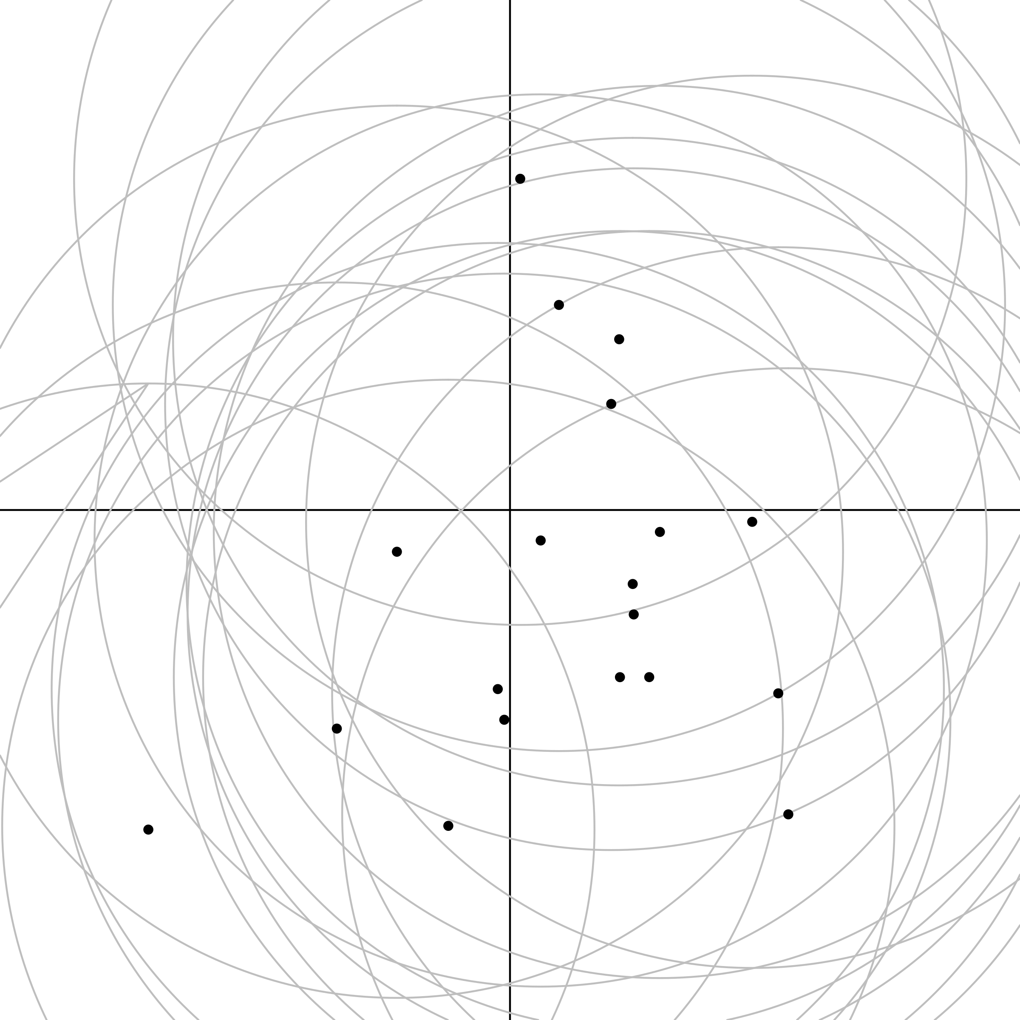
NP _ed about XP
NP _ed

Slide 125
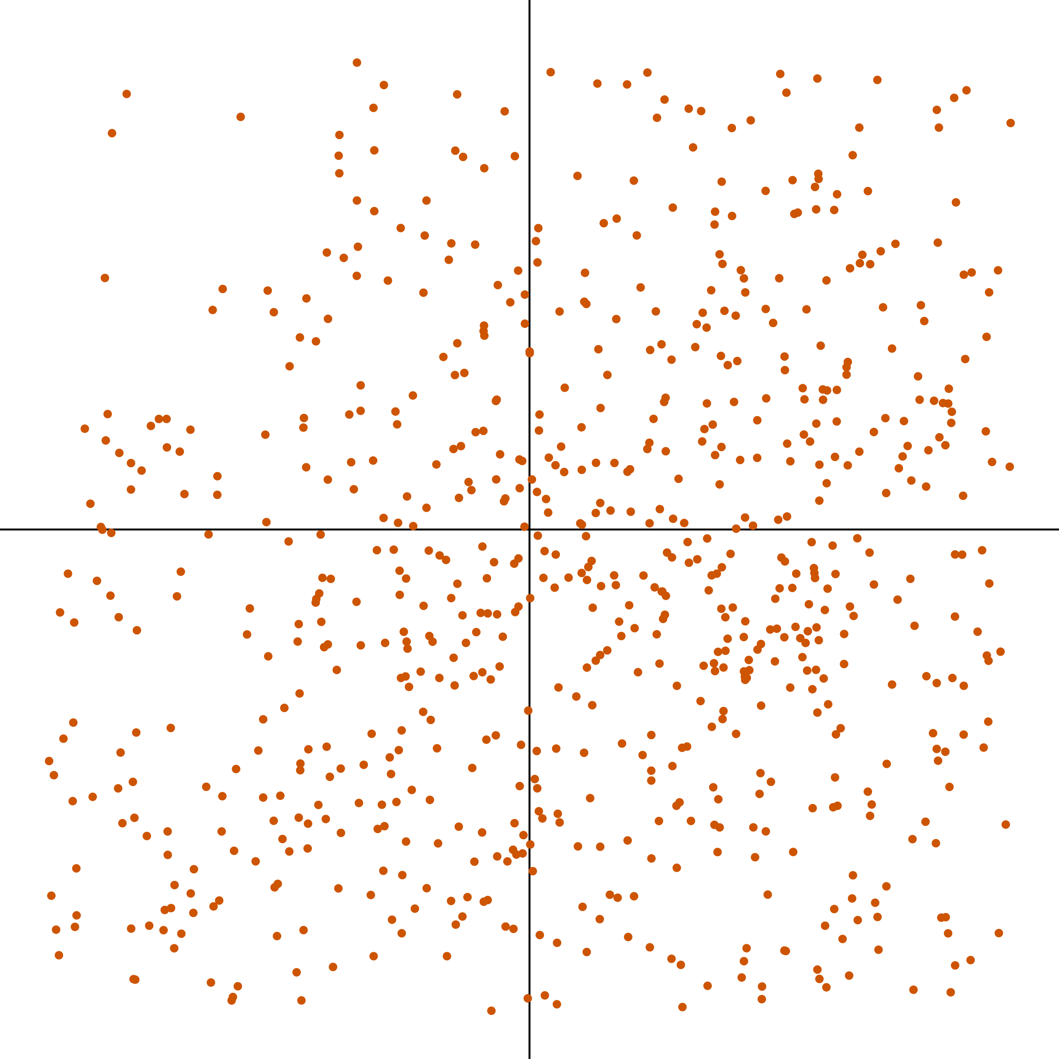
NP _ed about XP
NP _ed

Slide 126
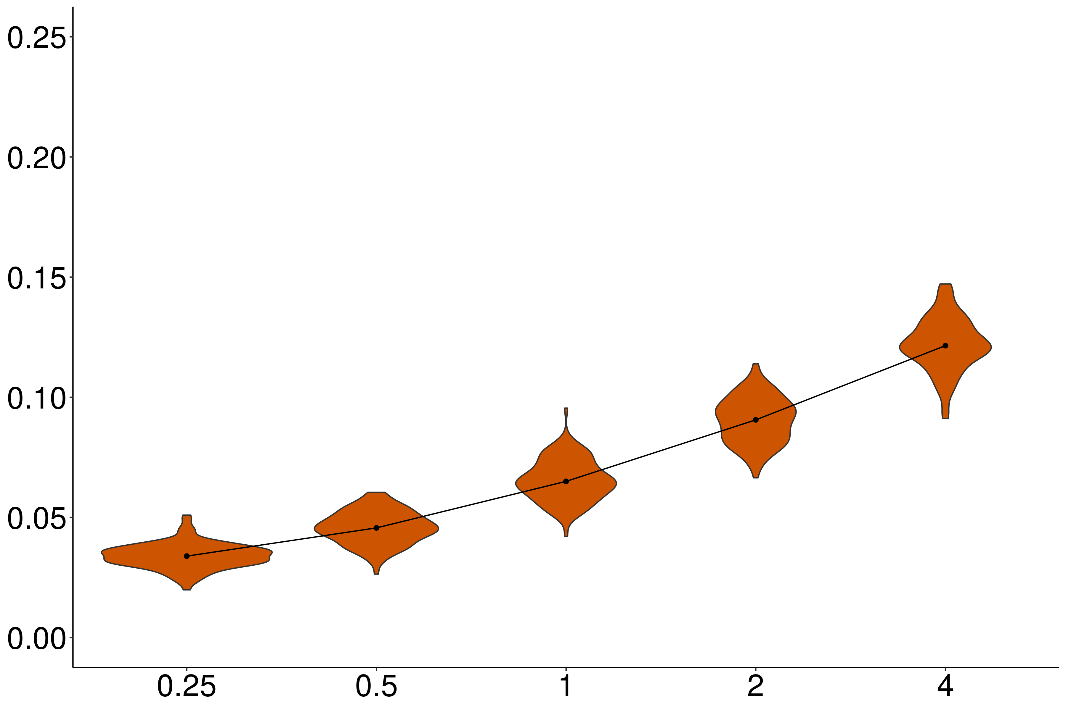
Independence
Proportion violations
Noise variance / acceptability variance

Slide 127
Independence
Proportion violations
Noise variance / acceptability variance

Slide 128
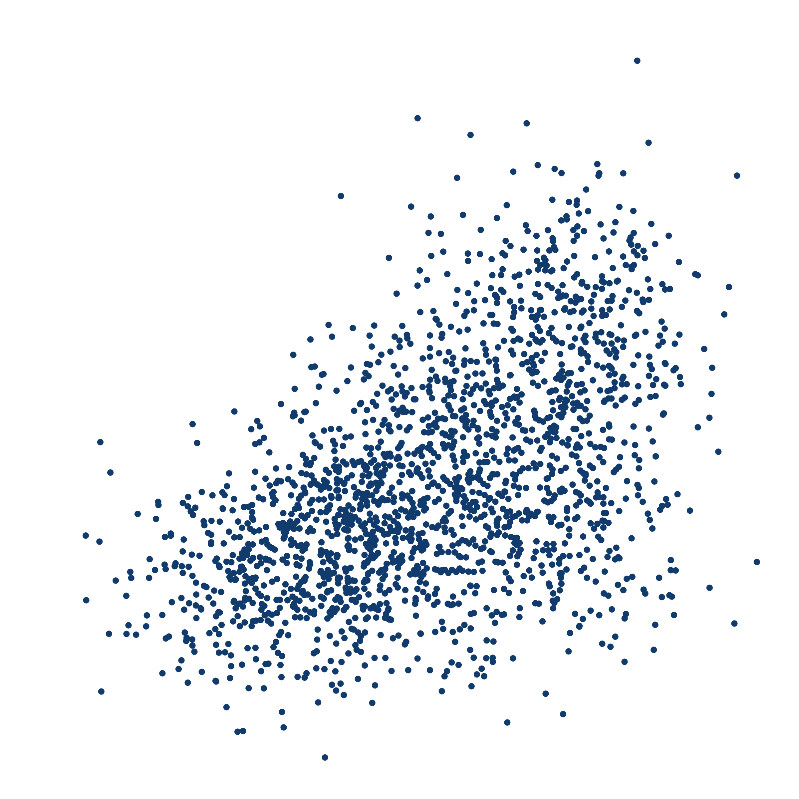
NP (was) _ed about whether S
NP (was) _ed

Slide 129
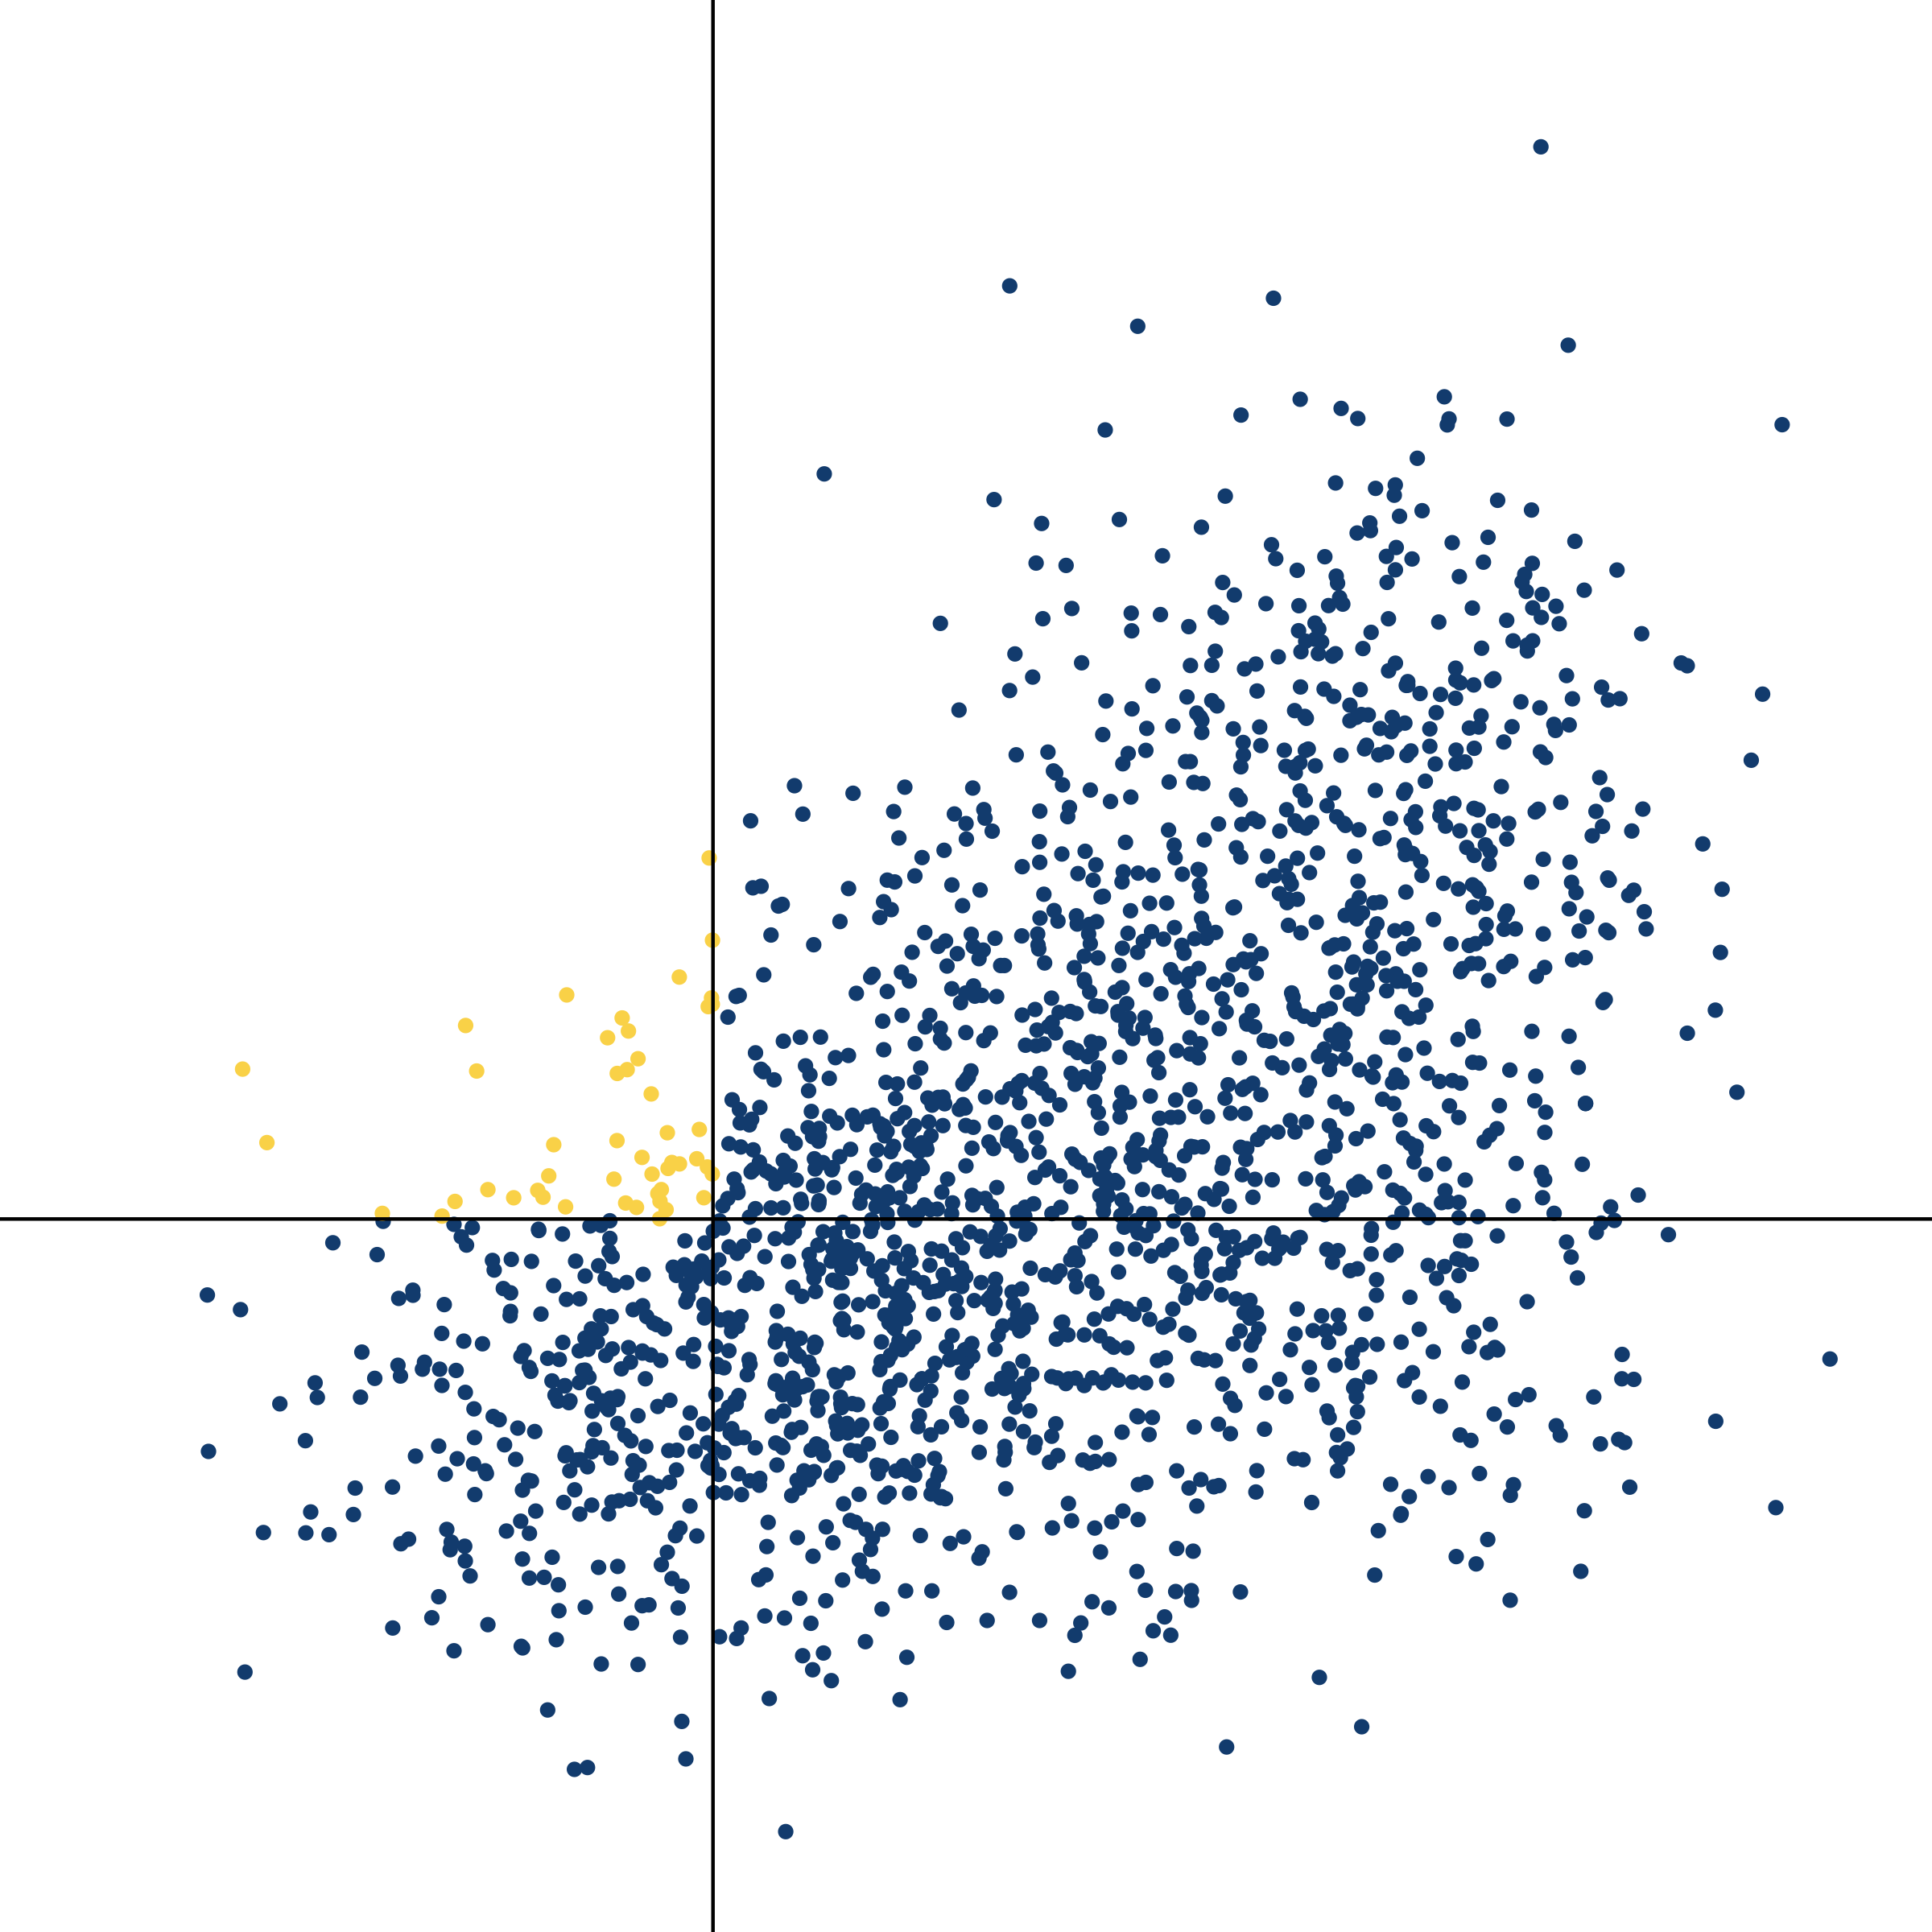
NP (was) _ed about whether S
NP (was) _ed

Slide 130
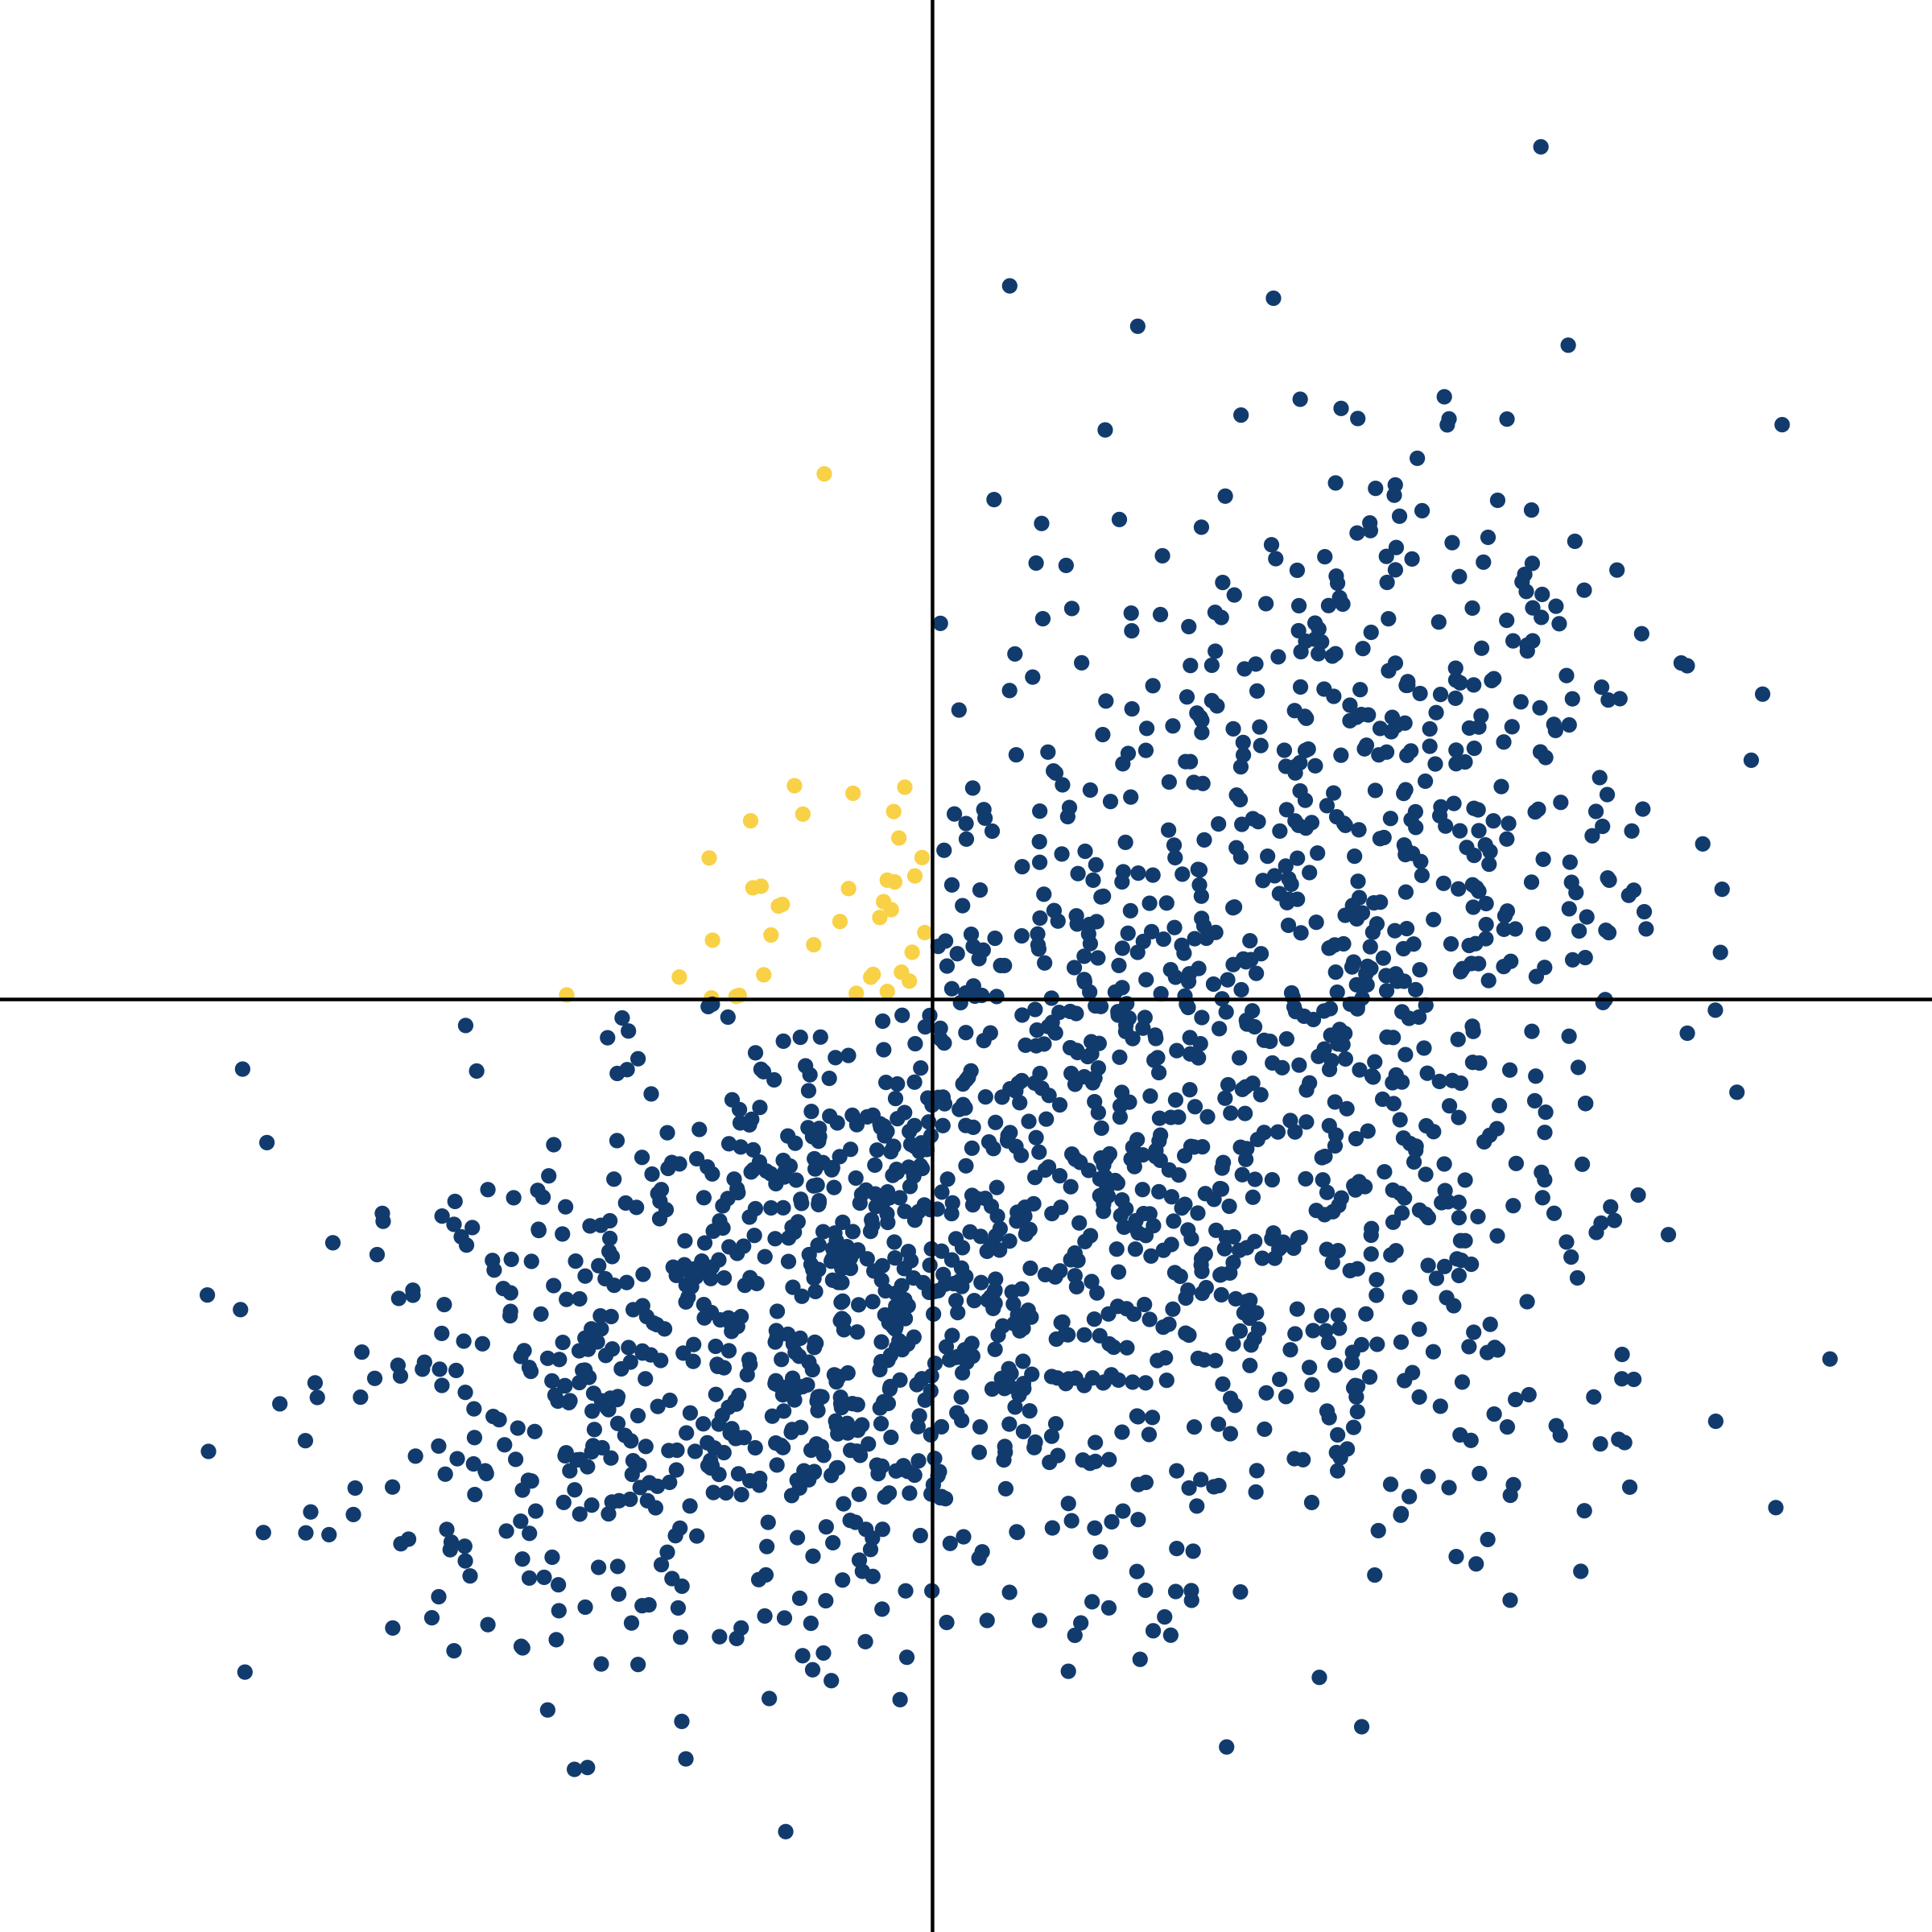
NP (was) _ed about whether S
NP (was) _ed

Slide 131
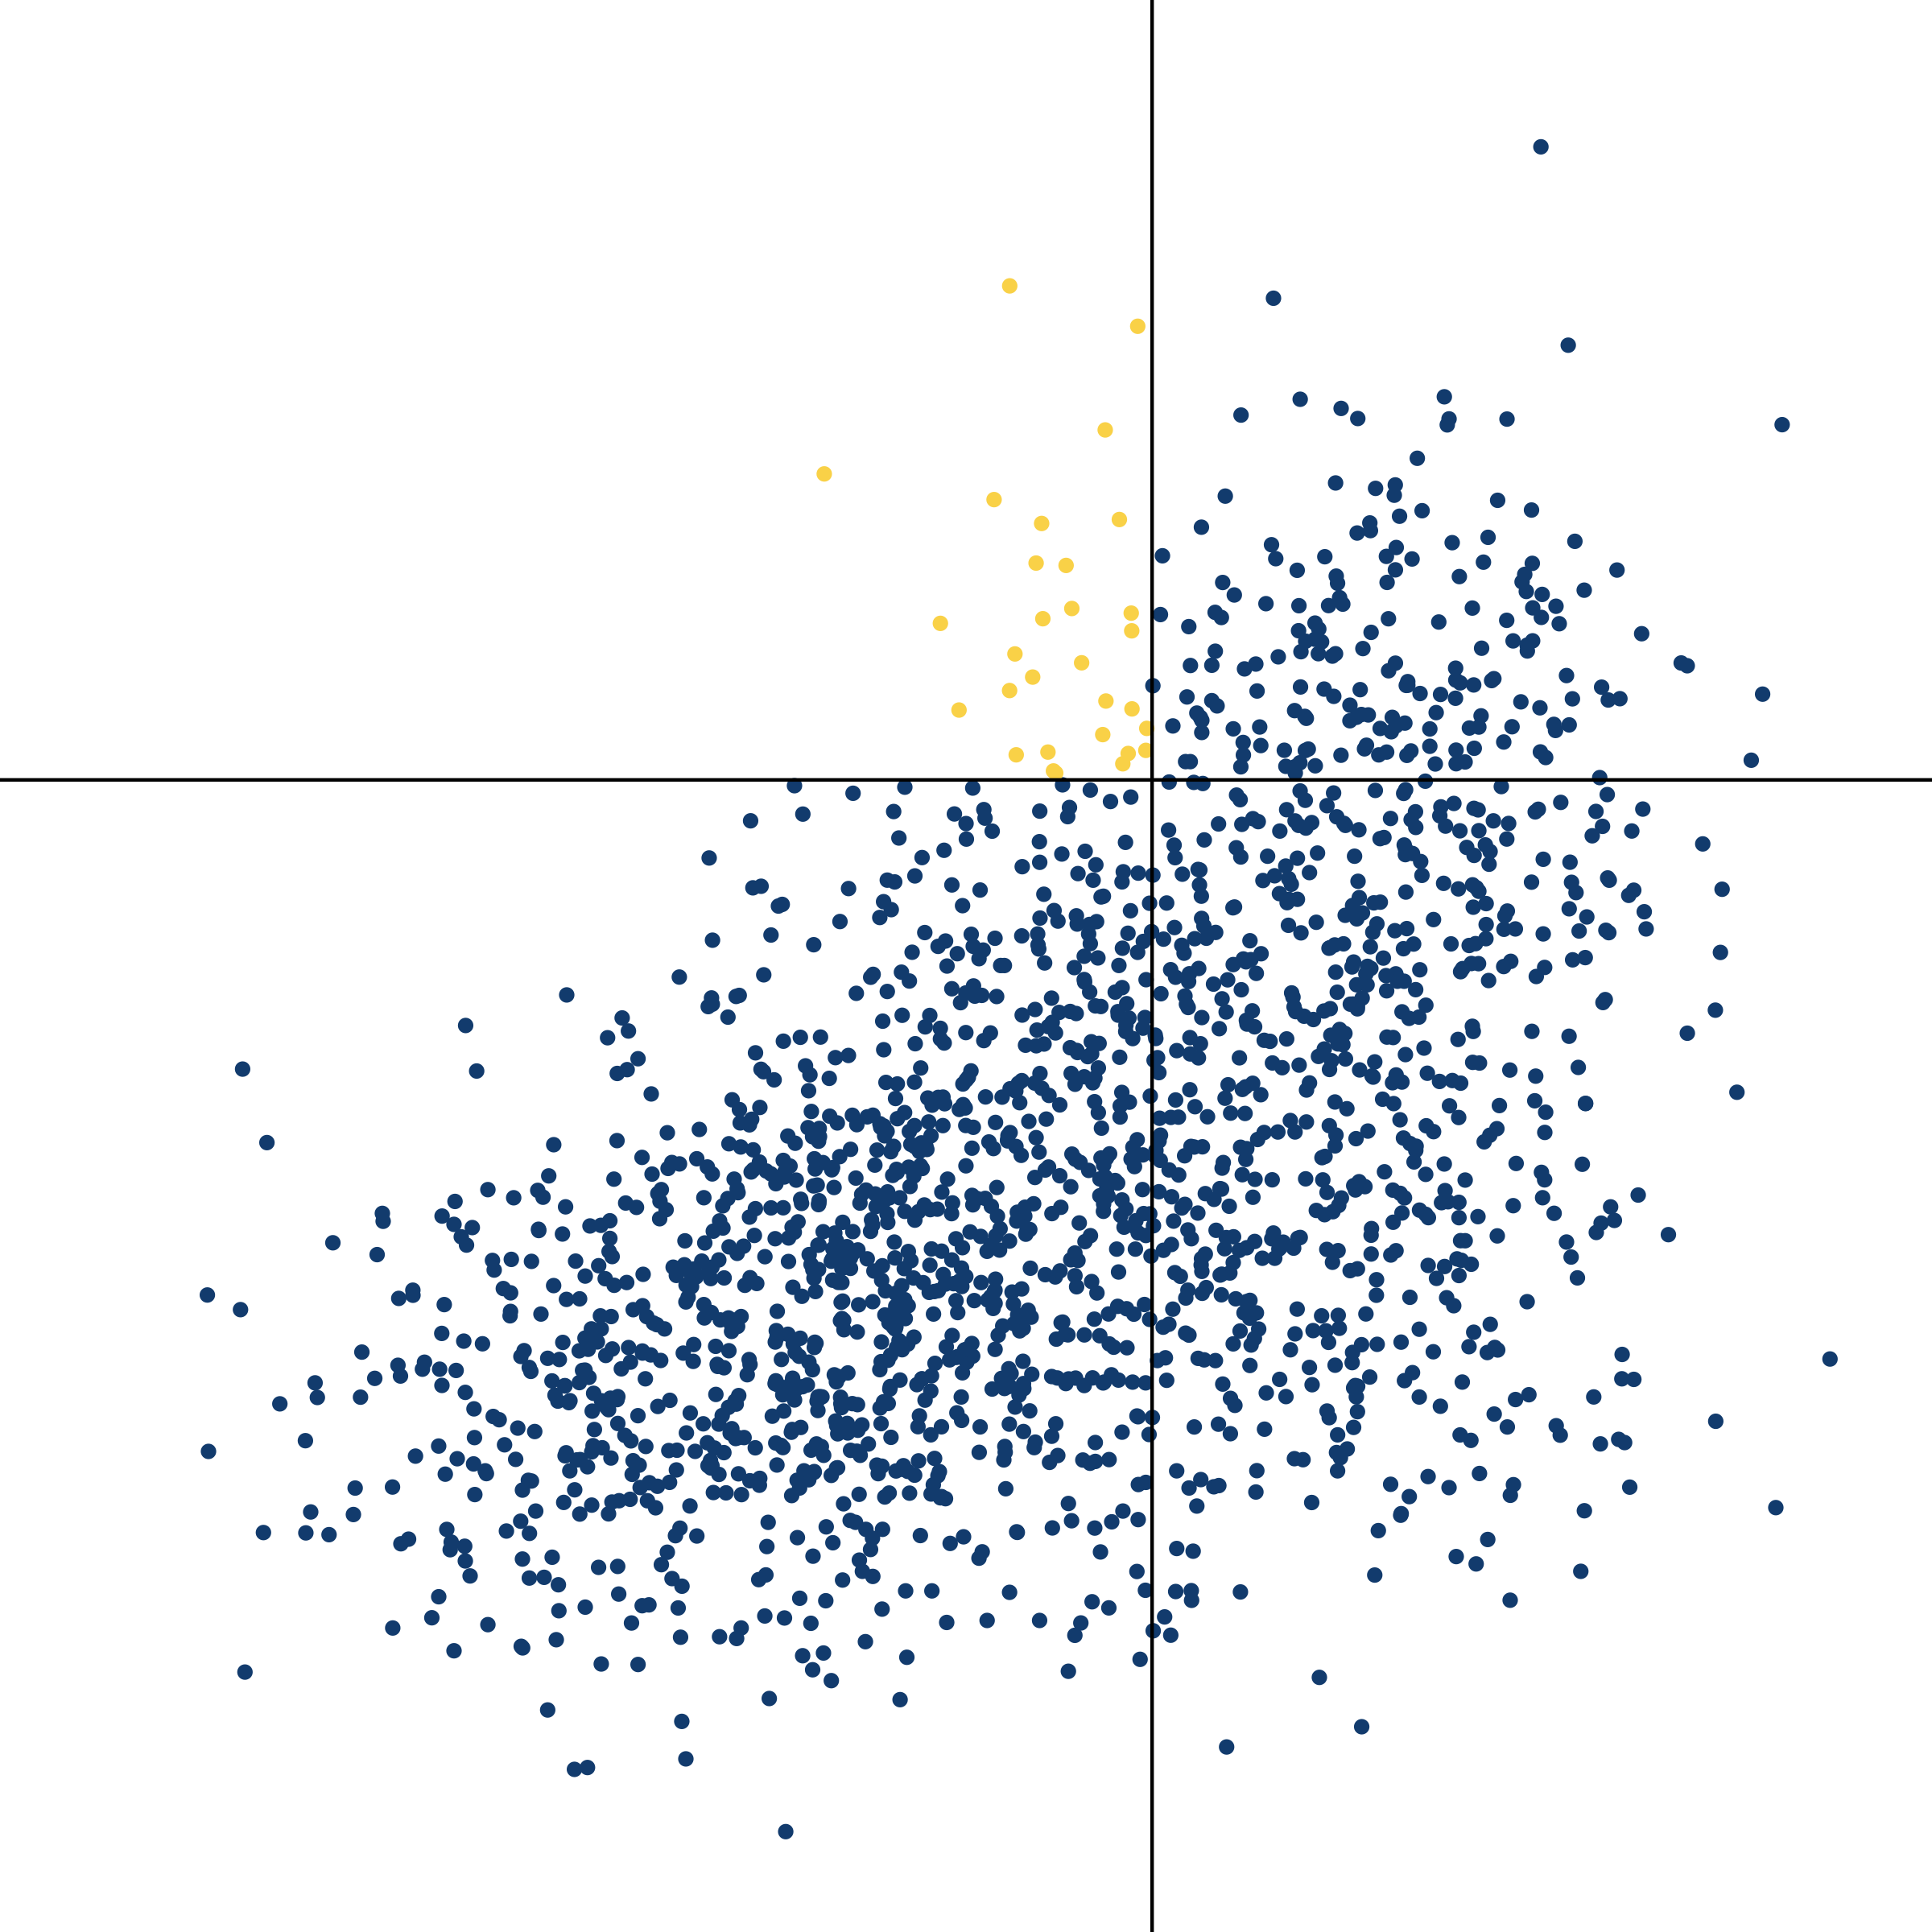
NP (was) _ed about whether S
NP (was) _ed

Slide 132
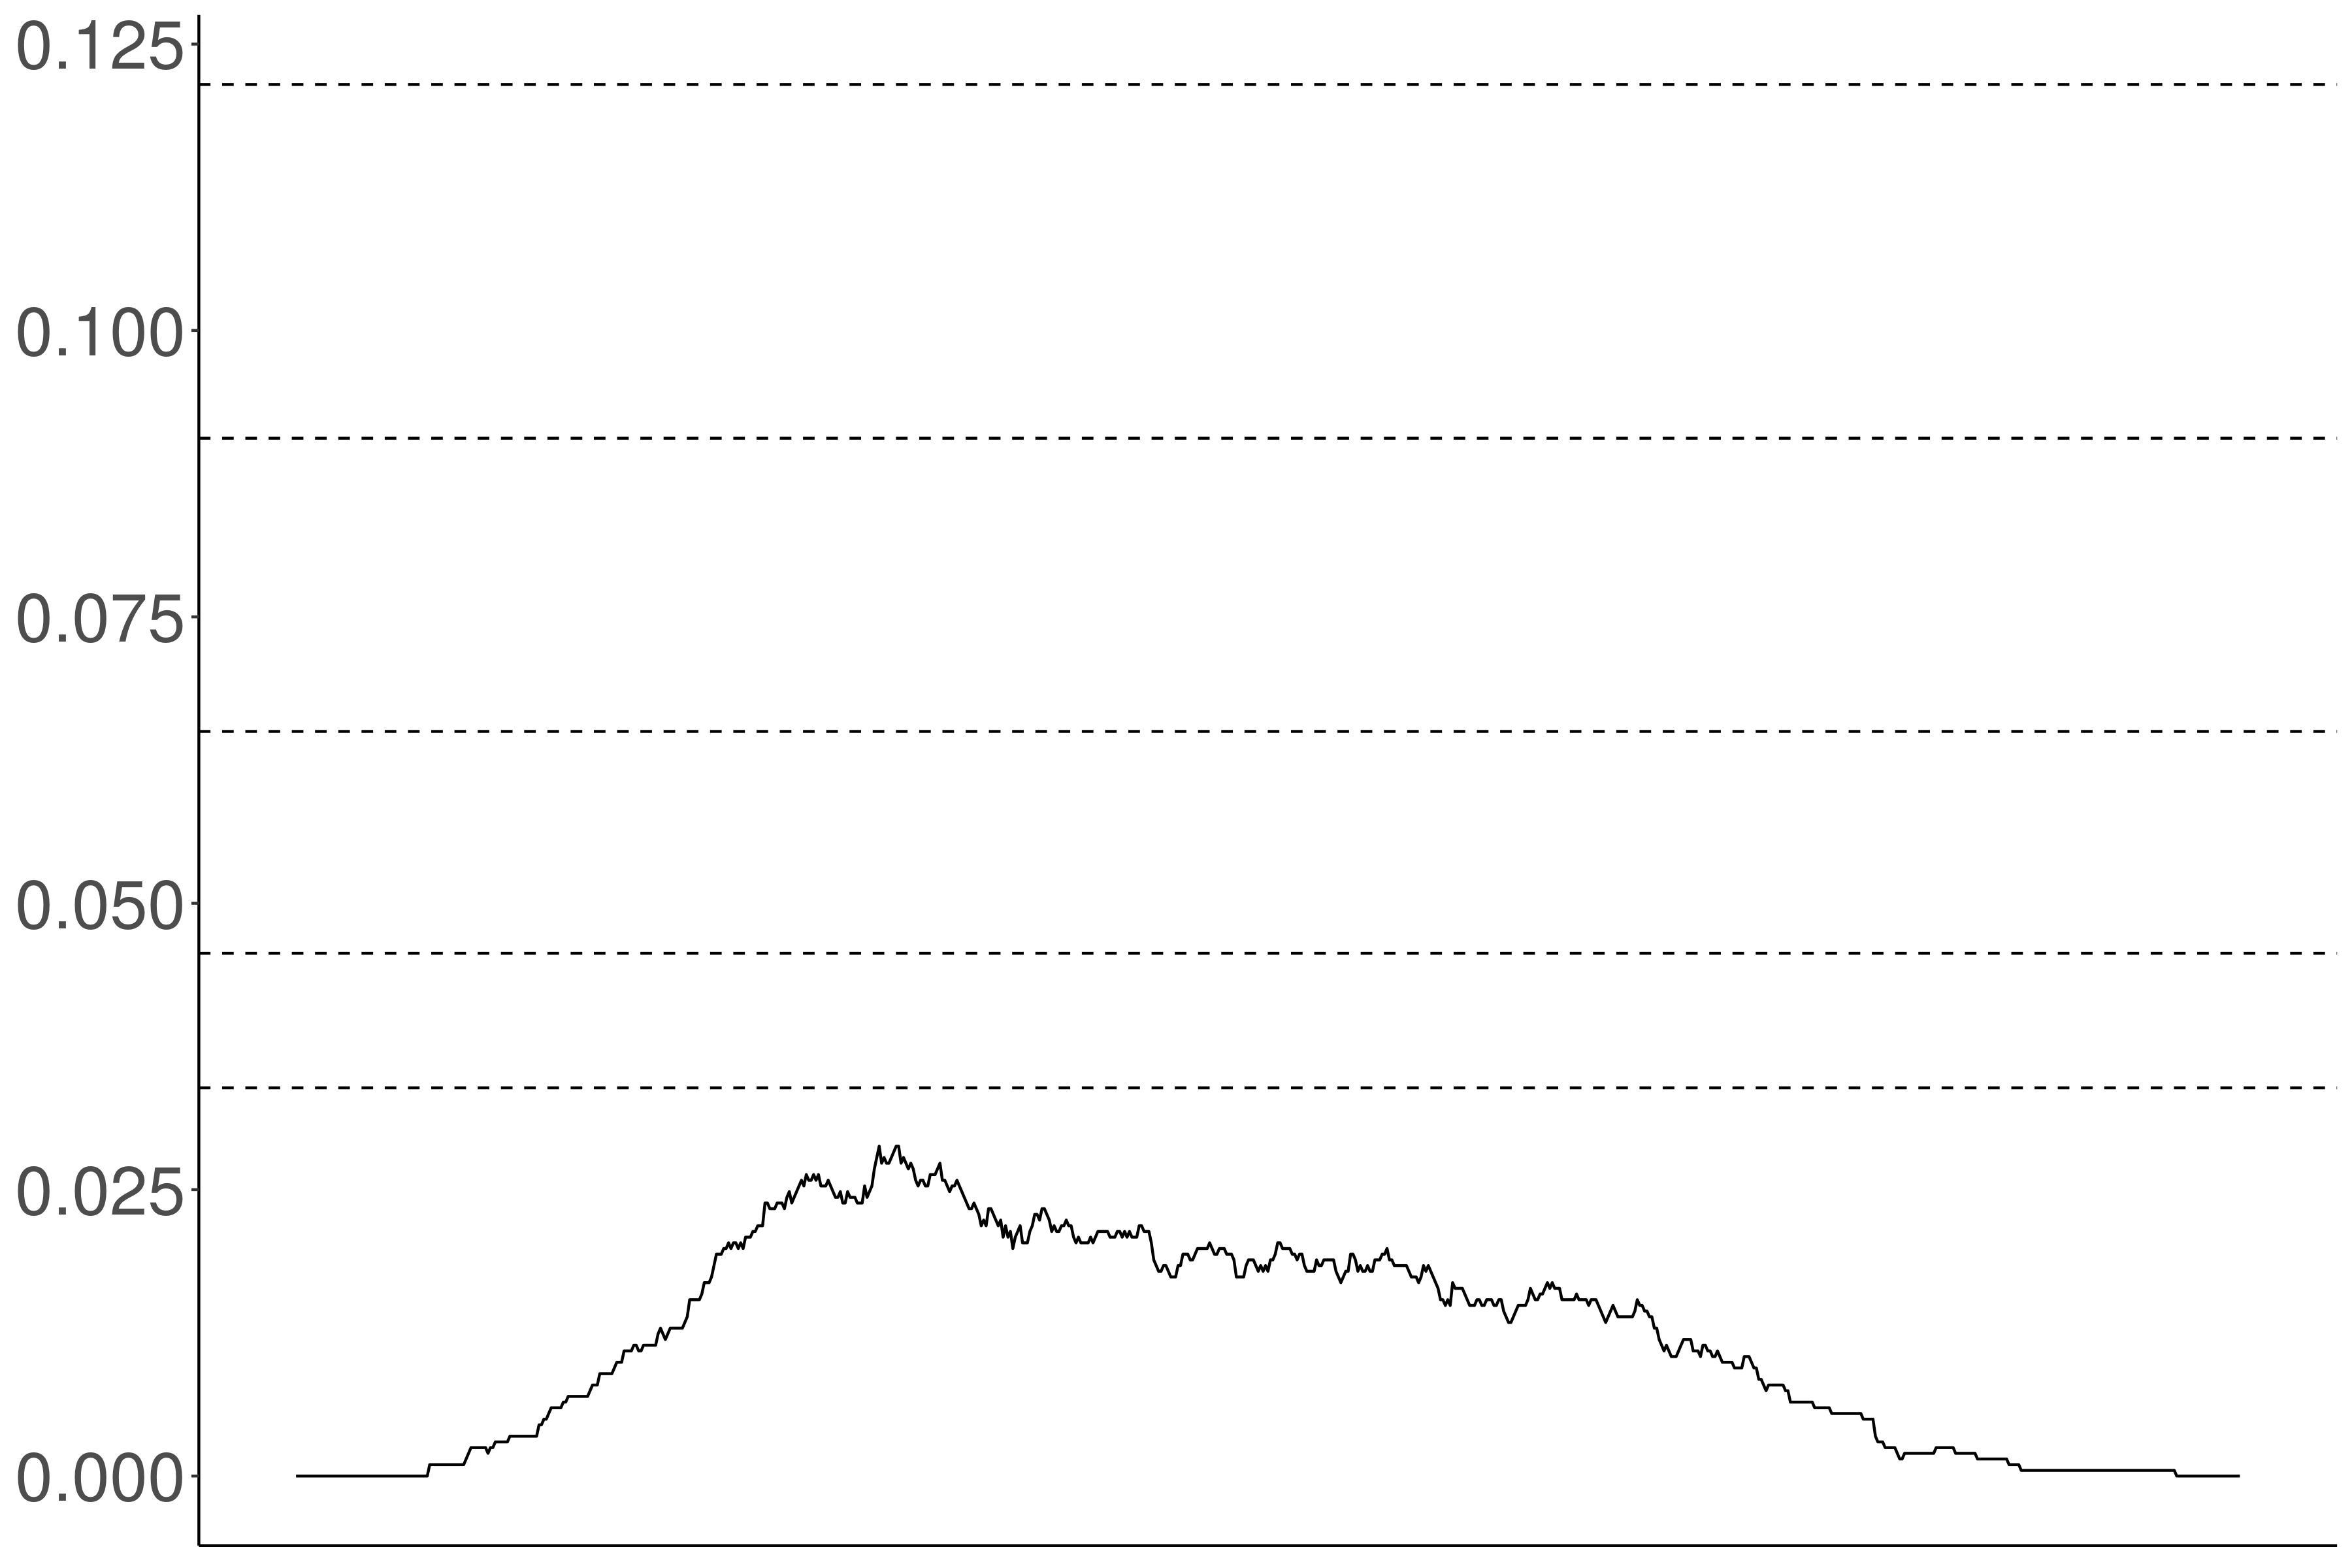
Proportion violations
Acceptability threshold

Slide 133
Independence
Proportion violations
Noise variance / acceptability variance

Slide 134
Proportion violations
Acceptability threshold

Slide 135
Proportion violations
Acceptability threshold

Slide 136
Appendix B
Inference Judgments

Slide 137
Veridicality inference
(not)
NP V S ⇝ S
NP not V S ⇝ (not) S
Doxastic inference
NP V S ⇝ NP believe S
NP not V S ⇝ NP (not) believe S
(not)
Bouletic inference
NP V S ⇝ NP want S
NP not V S ⇝ NP (not) want S
(not)
Neg-raising inference
NP not V S ⇝ NP V not S

Slide 138
Recipe
Validate a bleaching paradigm for collecting judgments for an inference type.
Select a set of frames of interest.
Select predicates acceptable in those frames using MegaAcceptability.
Collect judgments using the paradigm.

Slide 139
Veridicality task

Slide 140
Kyle Rawlins
Johns Hopkins University
Ben Van Durme
Johns Hopkins University
Rachel Rudinger
University of Maryland

Slide 141
Someone was irritated that a particular thing happened.
Veridicality task
Did that thing happen?
no maybe or maybe not yes

Slide 142
NP _ that S
Someone {knew, didn't know} that a particular thing happened.
NP be _ that S
Someone {was, wasn't} surprised that a particular thing happened.
NP _ for NP to VP
Someone {needed, didn’t need} for a particular thing to happen.
NP _ NP to VP[+/-eventive]
Someone {told, didn’t tell} a particular person to do a particular thing.
Someone {believed, didn’t believe} a particular person to have a particular thing.
NP be _ to VP[+/-eventive]
A particular person {was, wasn’t} excited to do a particular thing.
A particular person {was, wasn’t} suspected to have a particular thing.
NP _ to VP[+/-eventive]
A particular person {managed, didn’t manage} to do a particular thing.
A particular person {seemed, didn’t seem} to have a particular thing.

Slide 143
Neg-raising task

Slide 144
Hannah An
University of Rochester

Slide 145
If I were to say I don’t think that a particular thing happened, how likely is it that I mean I think that that thing didn’t happen?
Neg-raising task
Extremely unlikely
Extremely likely

Slide 146
NP _ that S
I {didn’t, don’t}
know that a particular thing happened.
A particular person {didn’t, doesn’t}
NP be _ that S
I {wasn’t, ‘m not}
surprised that a particular thing happened.
A particular person {wasn’t, isn’t}
NP be _ to VP[+/-eventive]
I {wasn’t, ‘m not}
told to do a particular thing.
A particular person {wasn’t, isn’t}
believed to have a particular thing.
NP _ to VP[+/-eventive]
I {didn’t, don’t}
managed to do a particular thing.
A particular person {didn’t, doesn’t}
seemed to have a particular thing.

Slide 147
Belief task

Slide 148
Ben Kane
OpenStream.AI
Will Gantt
Johns Hopkins University

Slide 149
If A knew that C happened, how likely is it that A believed that C happened?
Belief task
Extremely unlikely
Extremely likely

Slide 150
If A persuaded B that C happened, how likely is it that B believed that C happened?
Belief task
Extremely unlikely
Extremely likely

Slide 151
If A was appalled that C happened, how likely is it that A wanted C to have happened?
Desire task
Extremely unlikely
Extremely likely

Slide 152
If A apologized to B that C happened, how likely is it that B wanted C to have happened?
Desire task
Extremely unlikely
Extremely likely

Slide 153
NP _ that S
A {knew, didn't know} that C happened.
NP _ NP that S
A {told, didn't tell} B that C happened.
NP _ to NP that S
A {said, didn't say} to B that C happened.
NP _ that S
A {was, wasn’t} surprised that C happened.
NP _ that S[+future]
A {hoped, didn't hope} that C would happen.
NP _ NP that S[+future]
A {promised, didn't promise} B that C would happen.
NP _ to NP that S[+future]
A {predicted, didn't predict} to B that C would happen.
NP _ that S[+future]
A {was, wasn’t} excited that C would happen.

Slide 154
In preparation!
Ben Kane
OpenStream.AI
Will Gantt
Johns Hopkins University

Slide 155
NP _ for NP to VP
A {wanted, didn’t want} for B to do C.
NP _ to VP[+/-eventive]
A {hoped, didn’t hope} to {do, have} C.
NP _ NP to VP[+/-eventive]
A {told, didn't tell} B to {do, have} C.
NP _ to NP to VP[+/-eventive]
A {said, didn't say} to B to {do, have} C.
NP be _ to VP[+/-eventive]
A {was, wasn’t} believed to {do, have} C.
NP _ NP VP
A {saw, didn’t see} B do C.
NP _ VPing
A {liked, didn’t like} doing C.

Slide 156
If A chose to do C, how likely is it that A intended to do C?
Intention task
Extremely unlikely
Extremely likely

Slide 157
Question
Is bleaching a valid method for capturing inferences associated with a verb in a frame?

Slide 158
Validation Strategy #1
Compare judgments for bleached items against judgments from trained linguists.
Validation Strategy #2
Compare judgments for bleached items to judgments for more contentful items.
Validation Strategy #3
Compare inference judgments for bleached items to acceptability judgments for distributional diagnostic.

Slide 159
Appendix C
Inference Validation #1

Slide 160
 | Neg-raising | Non-neg-raising
NP __ that S | think, believe, feel, reckon, figure, guess, suppose, imagine | announce, claim, assert, report, know, realize, notice, find out
NP __ to VP | want, wish, happen, seem, plan, intend, mean, turn out | love, hate, need, continue, try, like, desire, decide

Slide 161
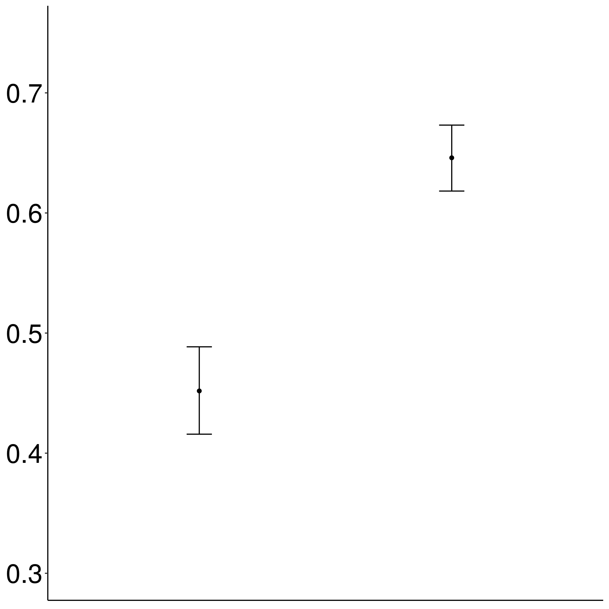
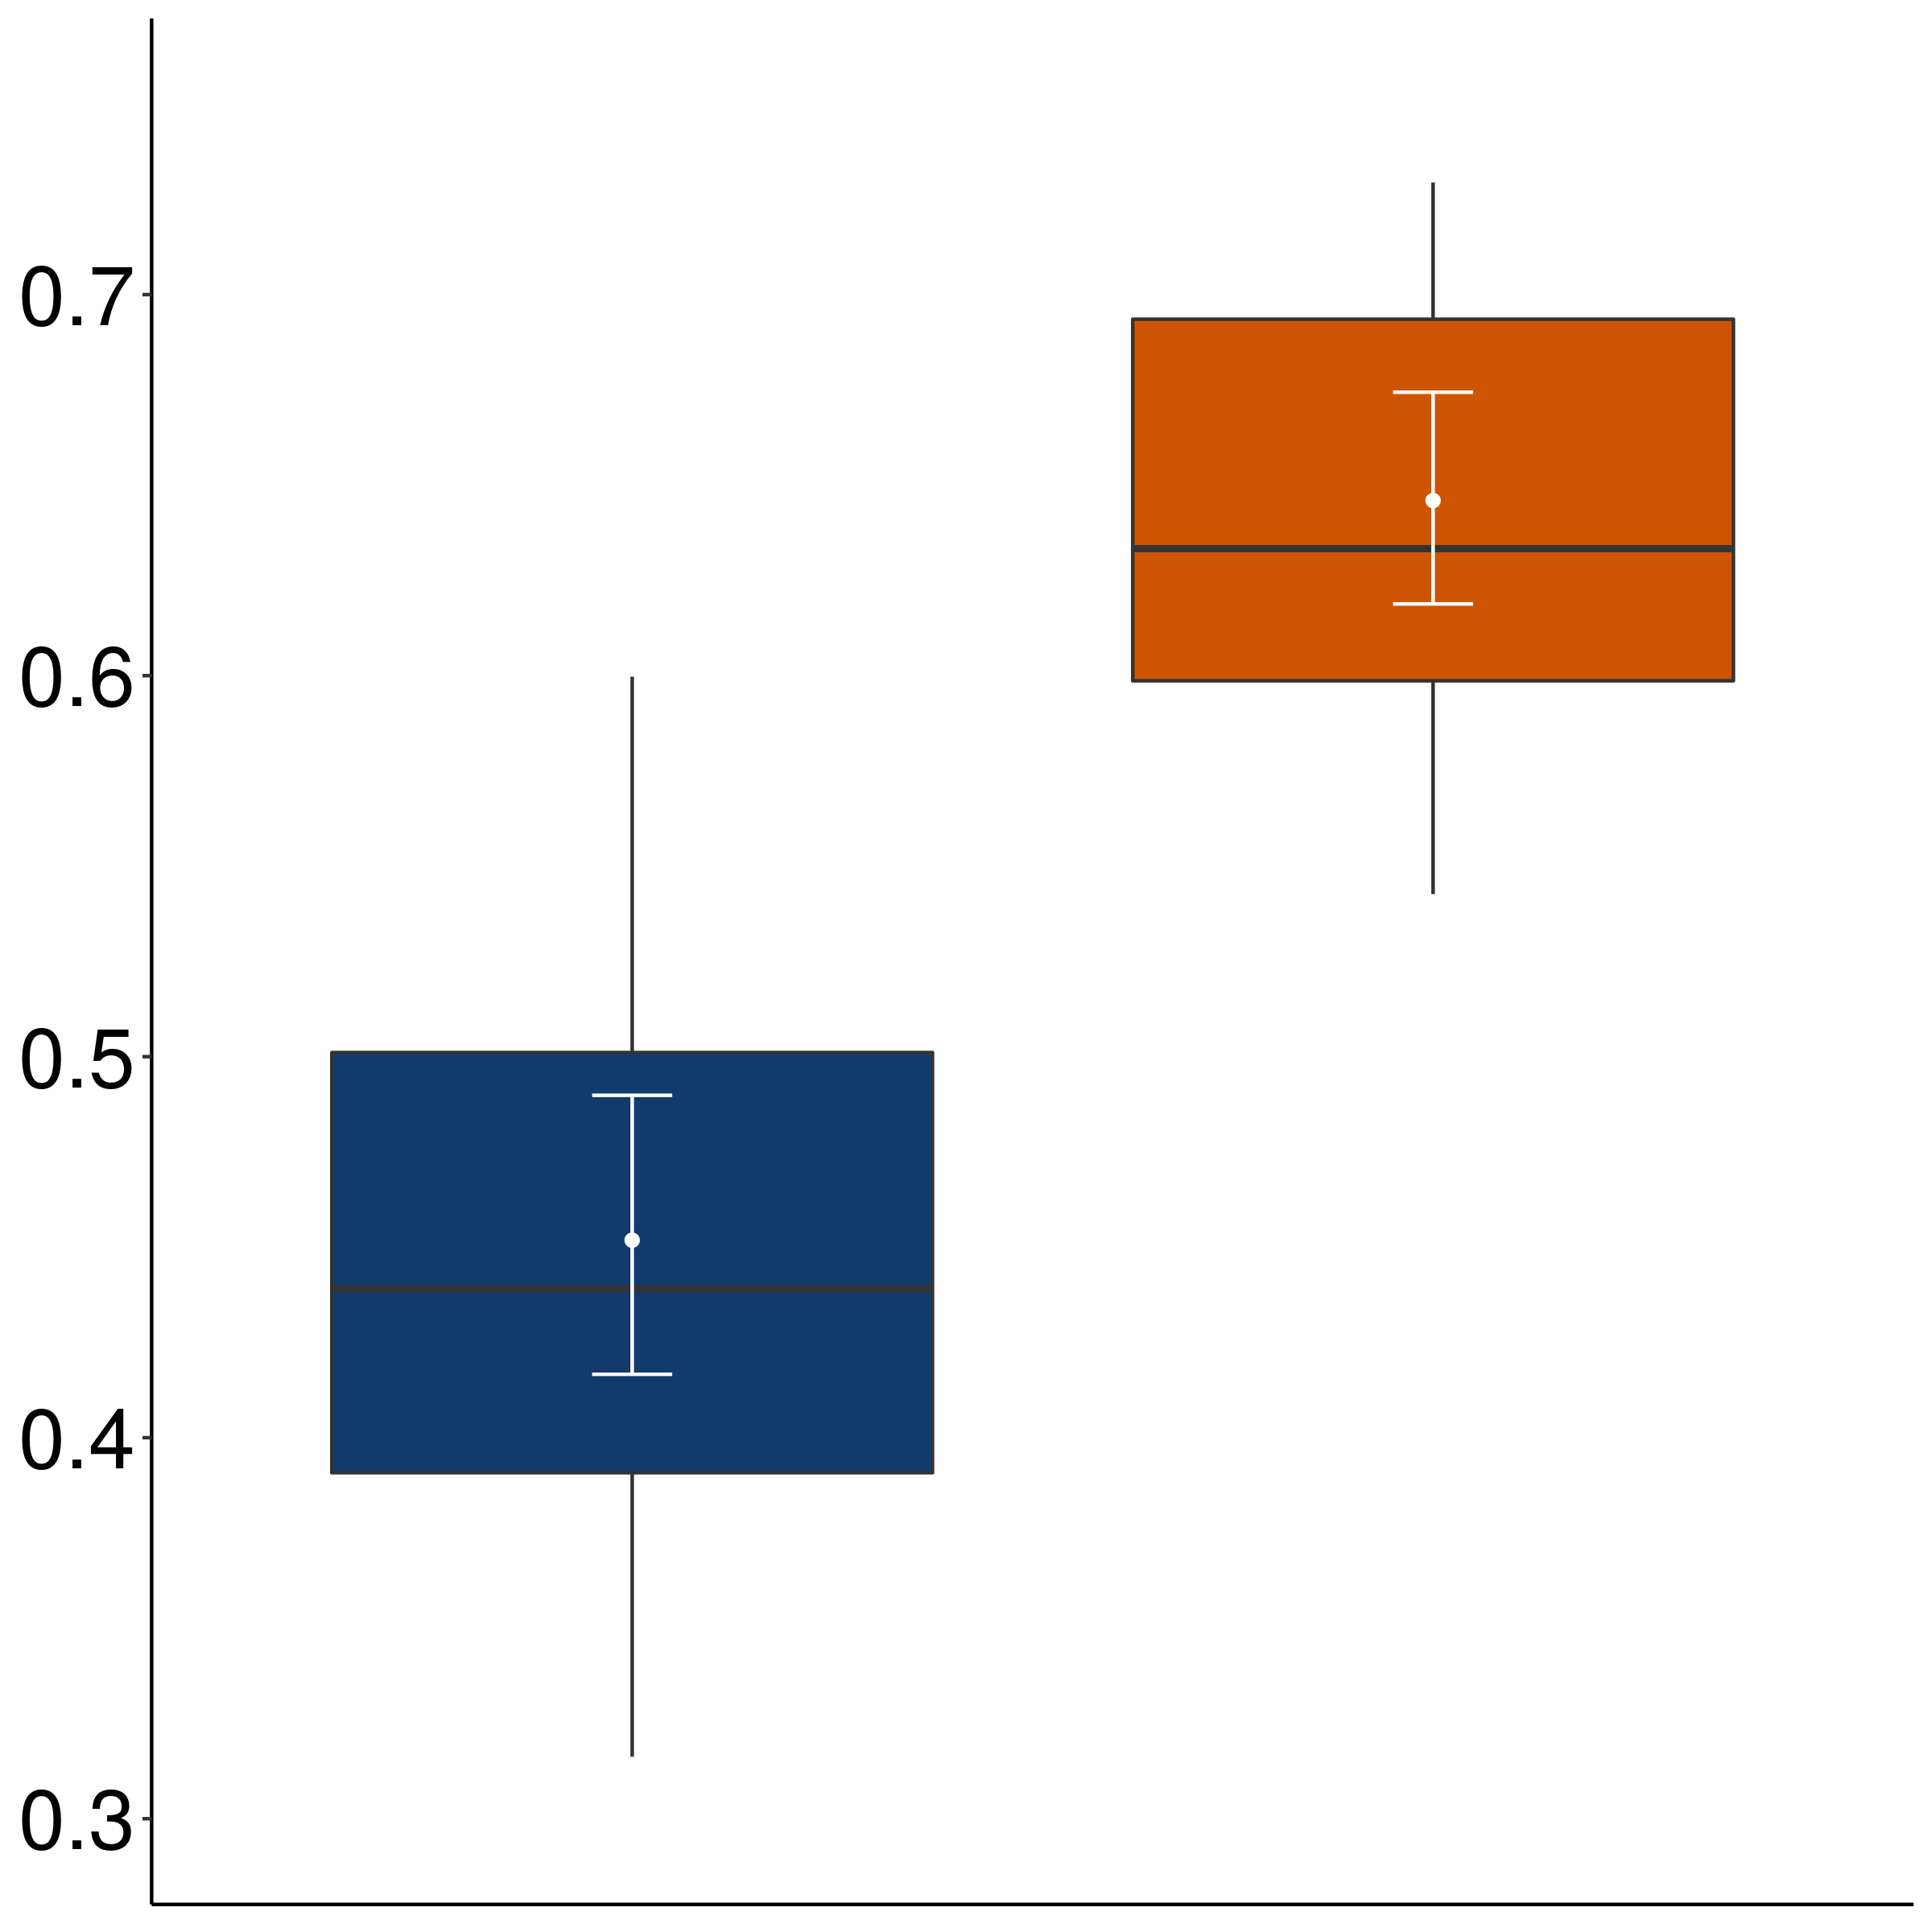
Mean rating of bleached example
Non-neg-raising
Neg-raising

Slide 162
Appendix D
Inference Validation #2

Slide 163
Implementation
For each verb-frame pair in validation set, sample five items from corpus.

Slide 164
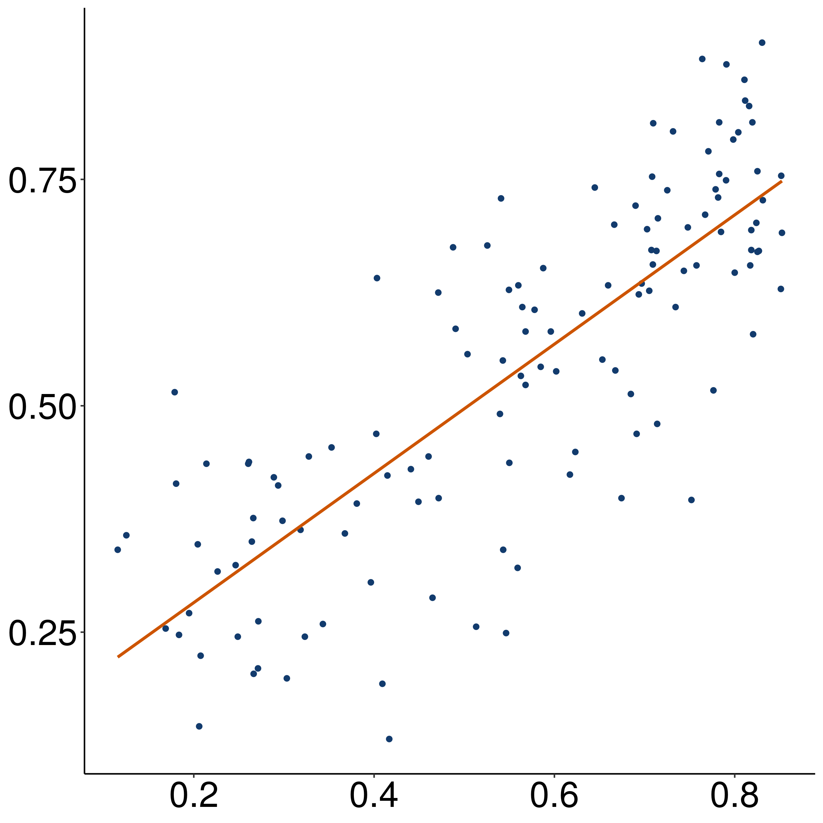
Mean rating of bleached example
r = 0.8
(p < 0.001)
Mean rating of corpus example

Slide 165
Appendix E
Inference Validation #3

Slide 166
Implementation
For each verb-frame pair in validation set, collect acceptability of strong NPI (additive either).
Jo didn’t do a particular thing, and…
…I don’t think that Bo did that thing either.
…I think that Bo didn’t do that thing either.

Slide 167
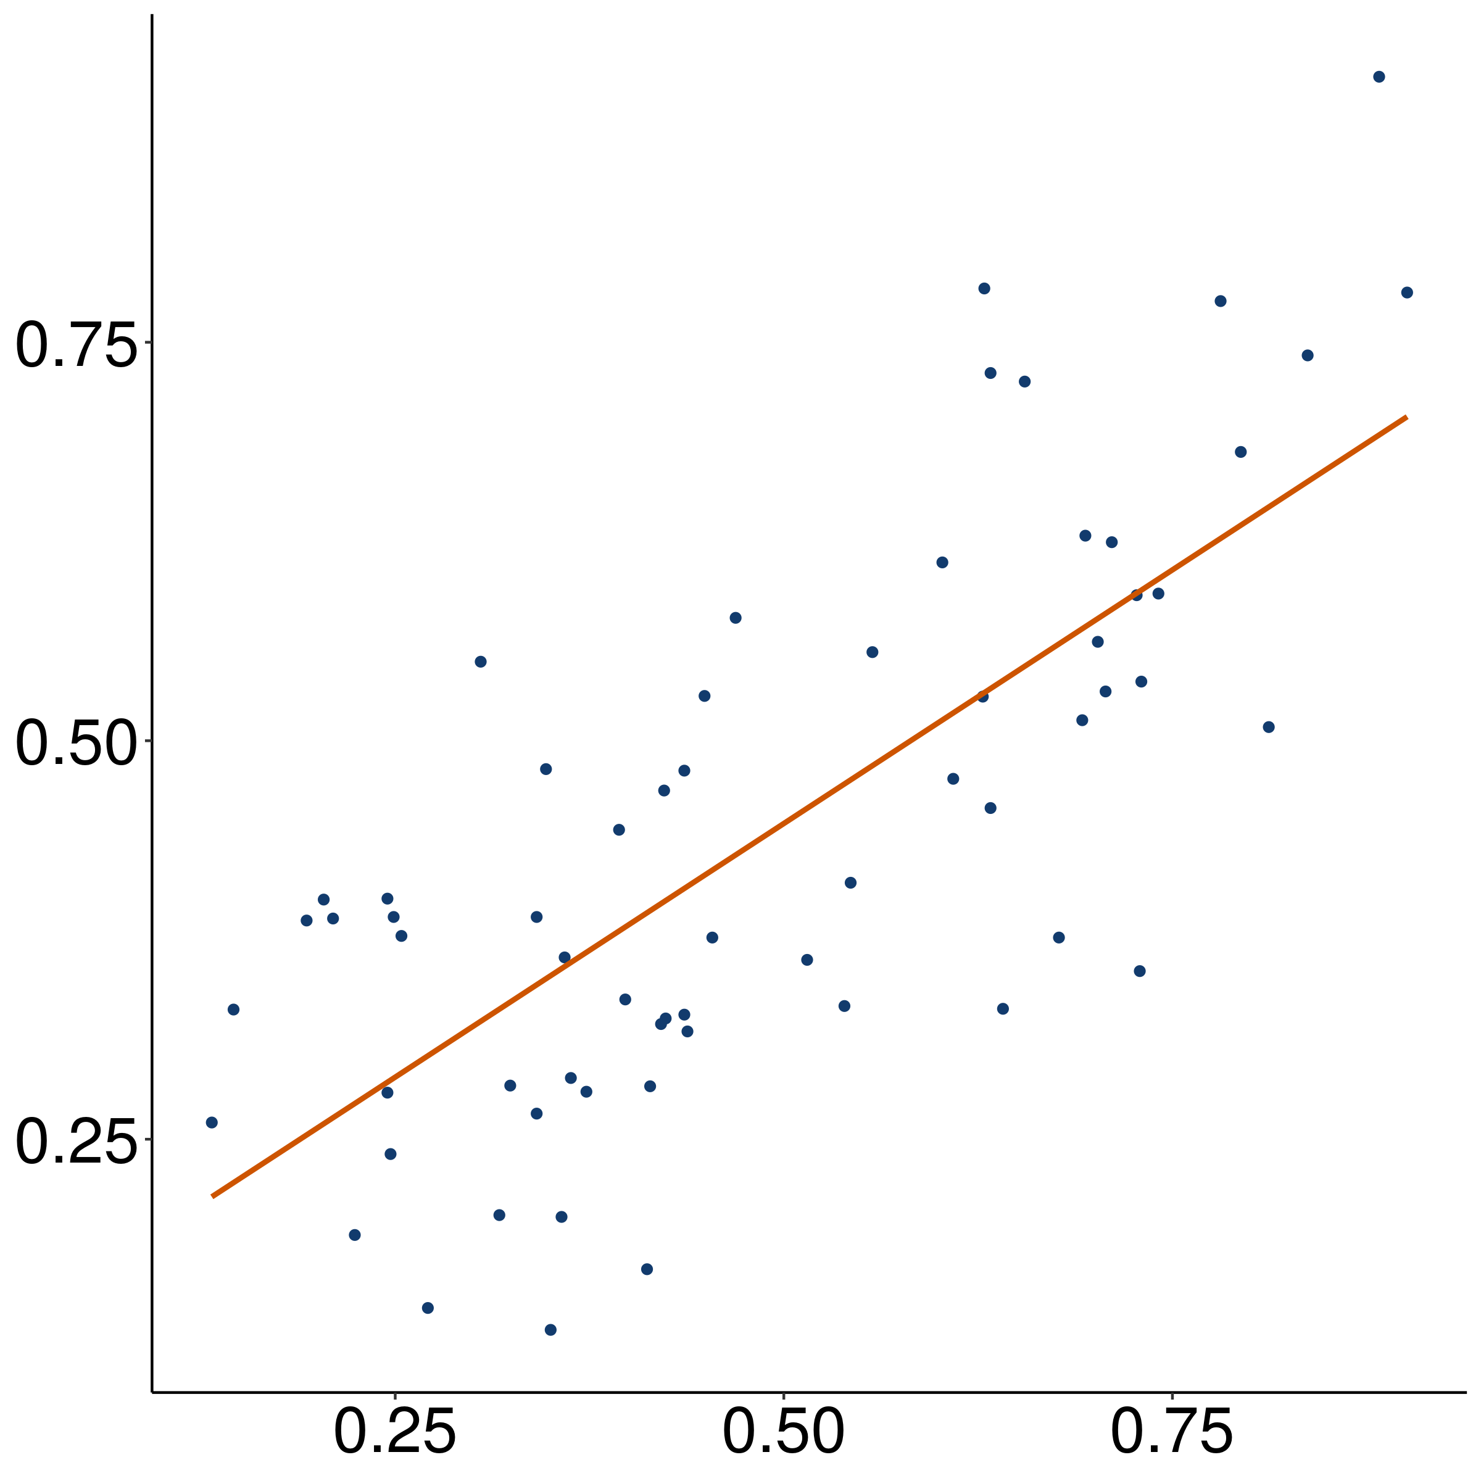
Mean acceptability of strong NPI
r = 0.77
(p < 0.001)
Mean rating of bleached example

Slide 168
Appendix F
Predicates in each class

Slide 169
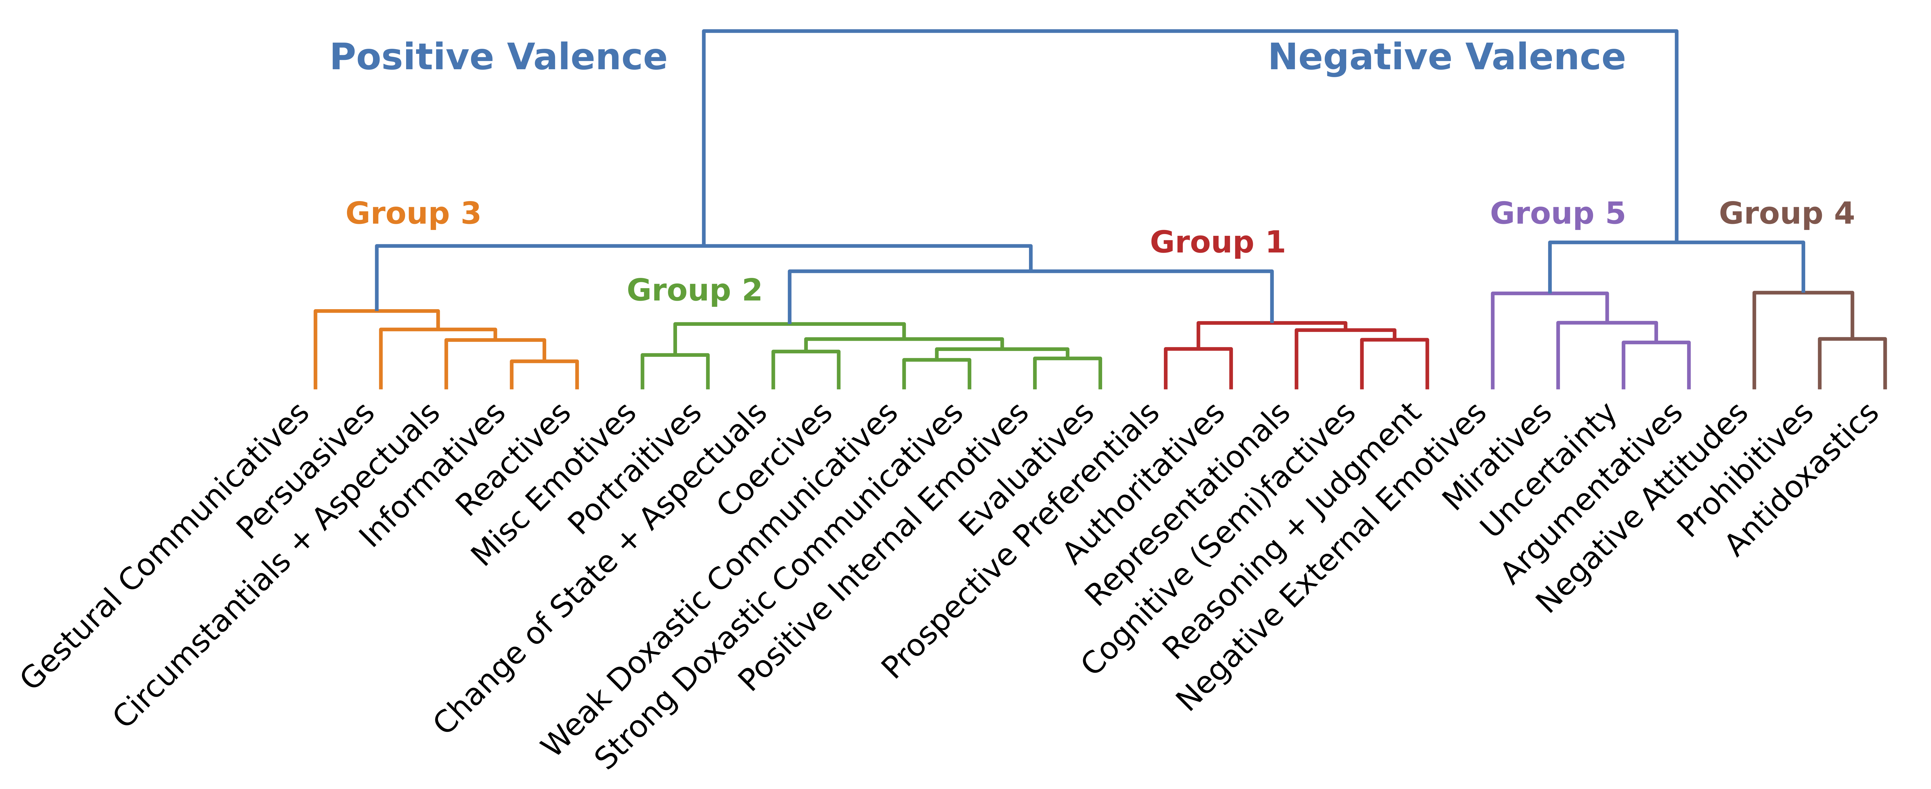
glare, grin, strut, talk, beam, frown, scowl, sulk, …

Slide 170
hound, pester, educate, interview, badger, brief, bug, challenge, …

Slide 171
bury, come, function, happen, invite, result, …

Slide 172
inform, remind, tell, advise, alert, ask, email, notify, warn, …

Slide 173
audit, discipline, approach, chastise, compliment, praise, demean, …

Slide 174
be fazed, be clouded, be gladdened, be affronted, be bored, be blessed, chide, …

Slide 175
defend, imitate, portray, address, conceal, depict, describe, detail, …

Slide 176
buy, delete, alter, attempt, insert, operate, cause, …

Slide 177
coerce, enlist, manipulate, allow, assign, bribe, coax, compel, force, …

Slide 178
articulate, communicate, explain, write, …

Slide 179
affirm, confirm, verify, acknowledge, clarify, …

Slide 180
be contented, be relieved, be amused, be charmed, be pleased, be comforted, …

Slide 181
check, investigate, contemplate, evaluate, examine, explore, …

Slide 182
aim, appear, compete, hunger, try, lust, attempt, start, …

Slide 183
expect, authorize, desire, request, allow, approve, …

Slide 184
dream, hope, think, agree, assume, …

Slide 185
discover, realize, recognize, know, find out, understand, …

Slide 186
manage, glean, opt, presuppose, signify, conclude, …

Slide 187
apologize, complain, cry, gloat, growl, sob, weep, …

Slide 188
(be) depress(ed), (be) disappoint(ed), (be) shock(ed), (be) disgust(ed), (be) displease(ed), (be) embarrass(ed), (be) frustrate(ed), (be) surprise(ed), …

Slide 189
confuse, distress, freak out, panic, perplex, puzzle, stump, baffle, …

Slide 190
fret, lie, agonize, bitch, brood, object, quarrel, quibble, whine, …

Slide 191
decline, fail, hate, neglect, refuse, regret, detest, dislike, …

Slide 192
denounce, disallow, face, prohibit, repress, abhor, admonish, …

Slide 193
doubt, question, dispute, fear, neglect, worry, …

Slide 194
Appendix G
Class-frame relationship

Slide 195
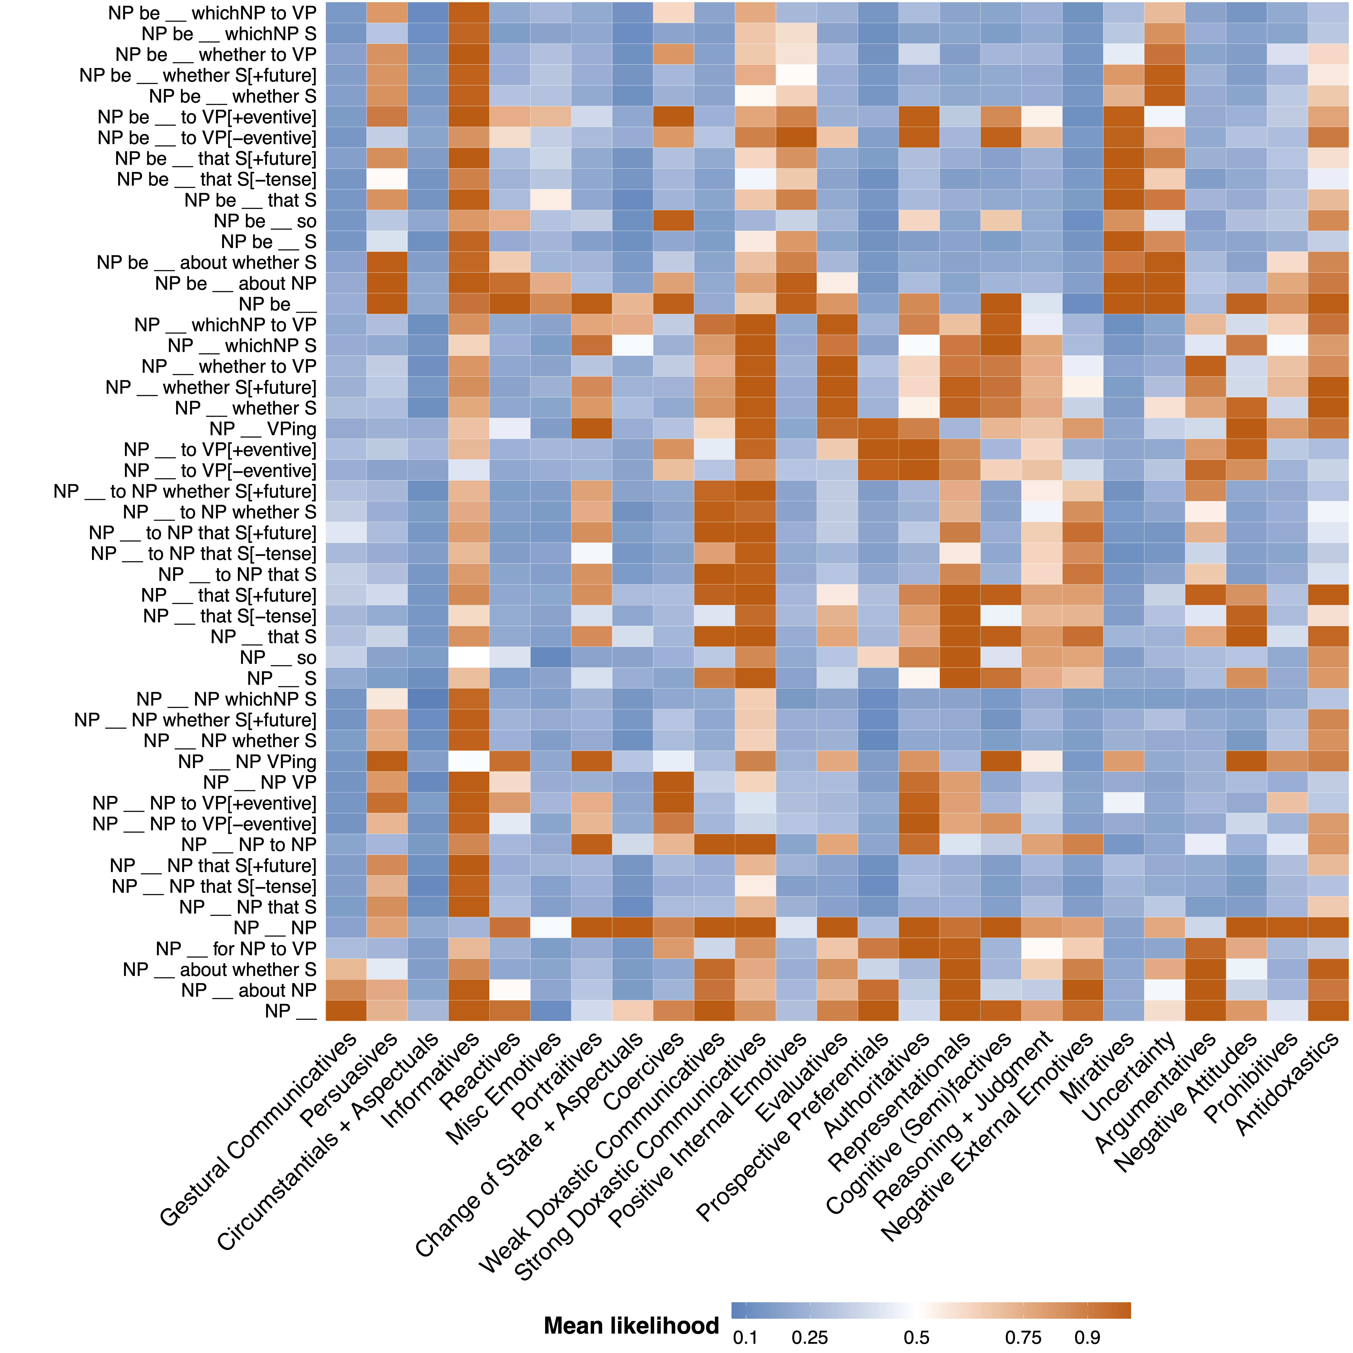
Simple past matrix

Slide 196
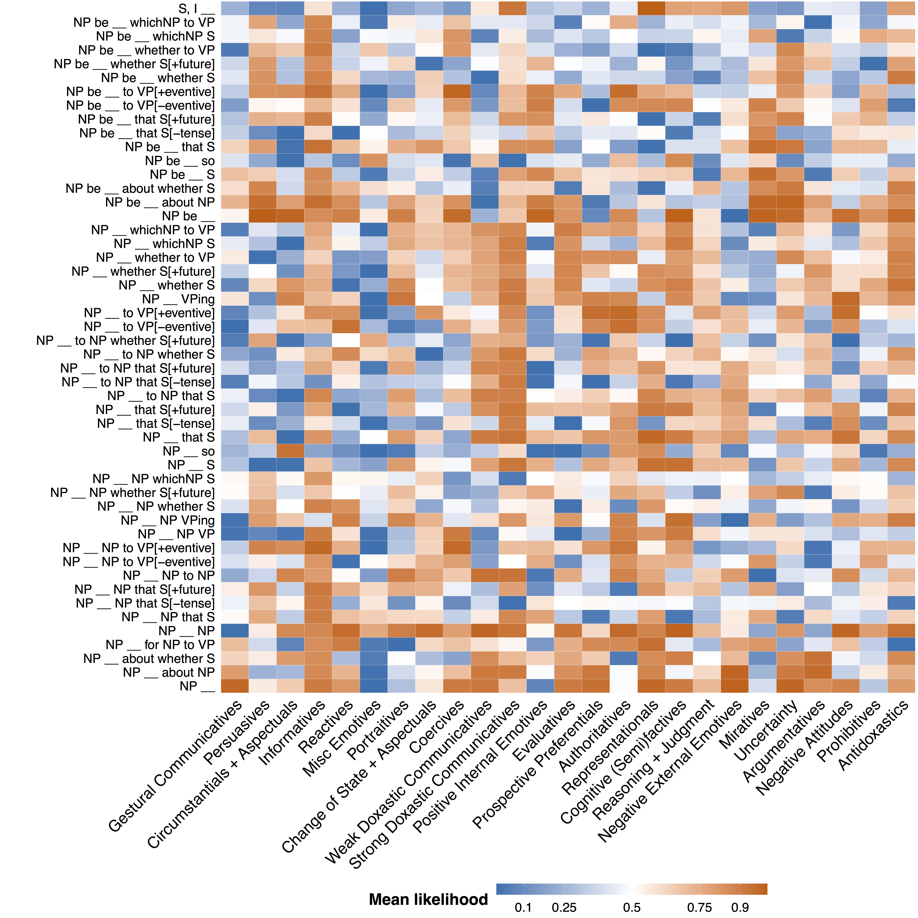
Simple present matrix

Slide 197
Past progressive matrix

Slide 198
Appendix H
Class-constituent relationship

Slide 199
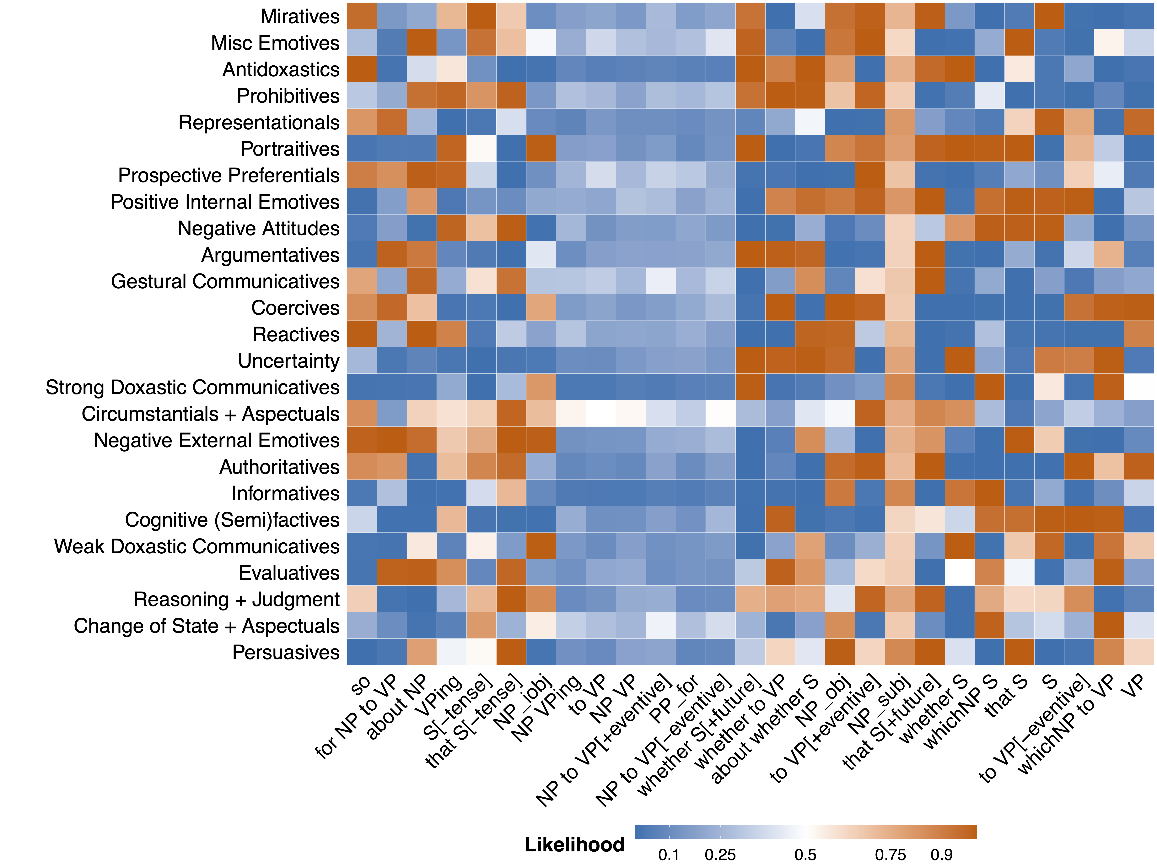

Slide 200
Appendix I
Class-inference relationships

Slide 206
Appendix J
Class-primitive relationships

Slide 207
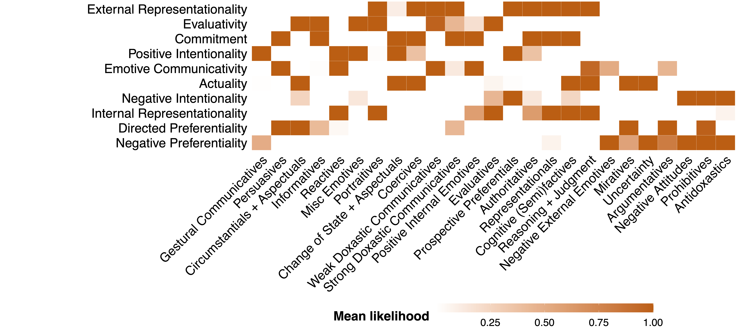

Slide 208
Appendix K
Primitive-constituent relationships

